Slide 1
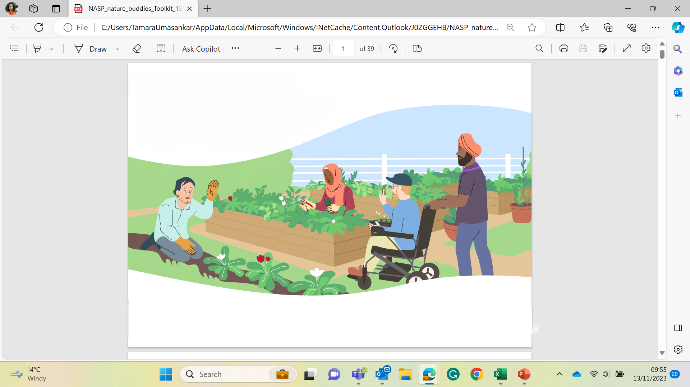










Nature Buddies
Induction

Slide 2
Nature Buddies: Your Journey
Induction
You join the Buddies induction with the Training Provider and other partners. Then work through your welcome booklet.
You log into the NHS elearning portal and complete short online training modules. You make your way through the useful resources in this guide to expand your understanding. (optional but highly recommended)
Training
Pairing Up
Your organisation will pair you up with a new or nervous member who you will then become a
buddy to.
Support
You will encourage, engage with and support your buddy, hopefully making them feel safe and welcome.
Feedback
You provide feedback to your organisation and/or your training provider and partners which helps improve buddies in the future.
What’s next
Hopefully your client is now a confident member of your group and you can use your new skills and learning to help more people.
2

Slide 3
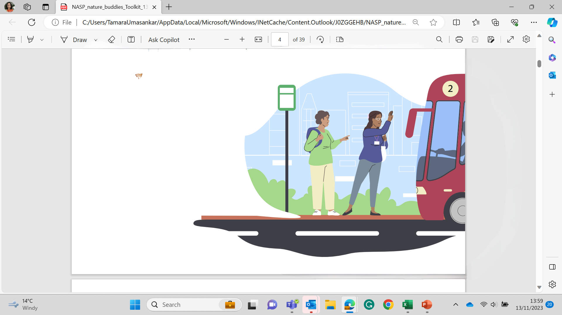
Nature Buddy
Purpose of the Role
A Nature Buddy is a volunteer whose role is to support individuals at a personalised level to help gradually increase their confidence and ability to enjoy engaging with nature.
A Nature Buddy will find what suits to the person best and will support them on their journey to living a happier and healthier life.
This might be through:
  Travel support – helping people access green spaces/activities
  Meet and greet role – being a friendly face at the gate
  Participant buddy – taking part alongside the person, sharing skills and facilitating social aspects
3

Slide 4
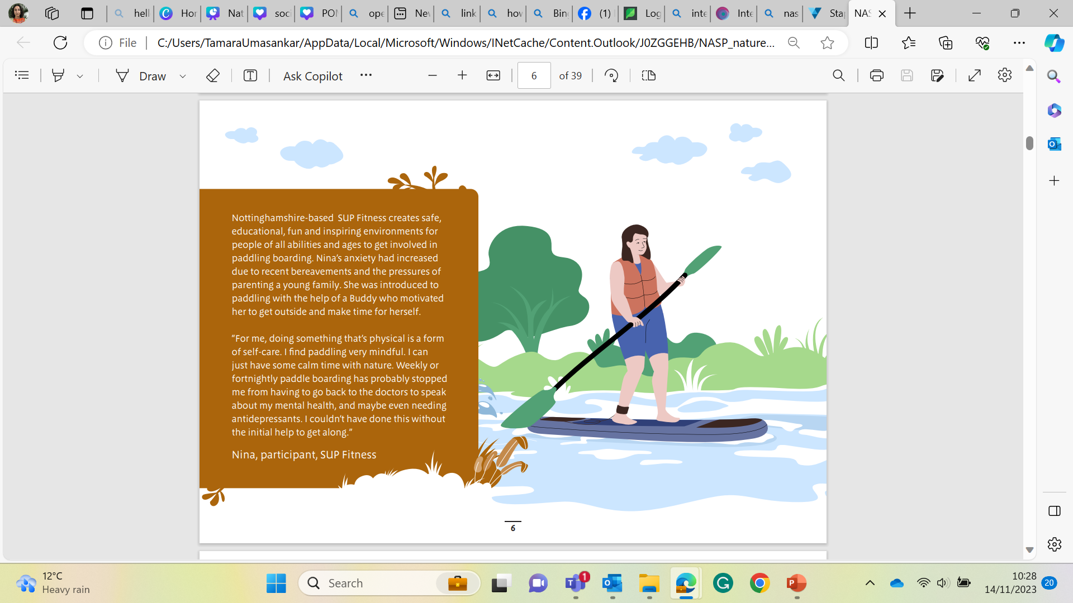
Nature Buddy
What you will be doing
Depending on what organisation you are working with you may be asked to:
  Provide regular support to enable people to walk or visit their local parks and open spaces.
  Encourage people who would not normally engage with outdoor environments
  Work with the person on an activity they would like to do, paying particular attention of likes, dislikes, past hobbies and interests to tailor the activity.
  Be aware of the key messages and benefits of health and well-being they can gain from being outdoors
4

Slide 5
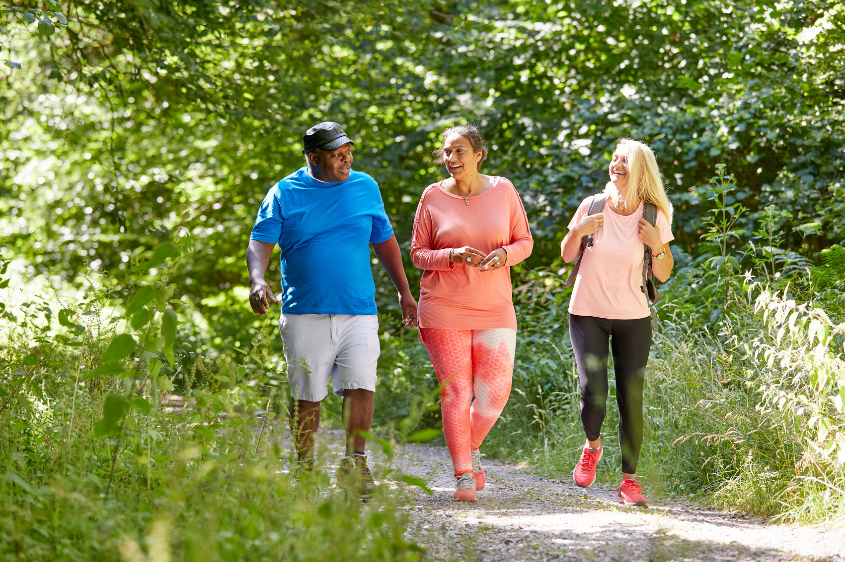
Nature Buddy
Required Skills, Experience and Qualities
  No special qualifications or experience needed.
  We are looking for volunteers who are understanding, patient, empathetic and good at listening.
  You should be enthusiastic about the benefits of outdoor environments and have an interest in nature, although you don’t have to be an expert.
  All volunteers may be subject to Disclosure and Barring checks (DBS).
5

Slide 6
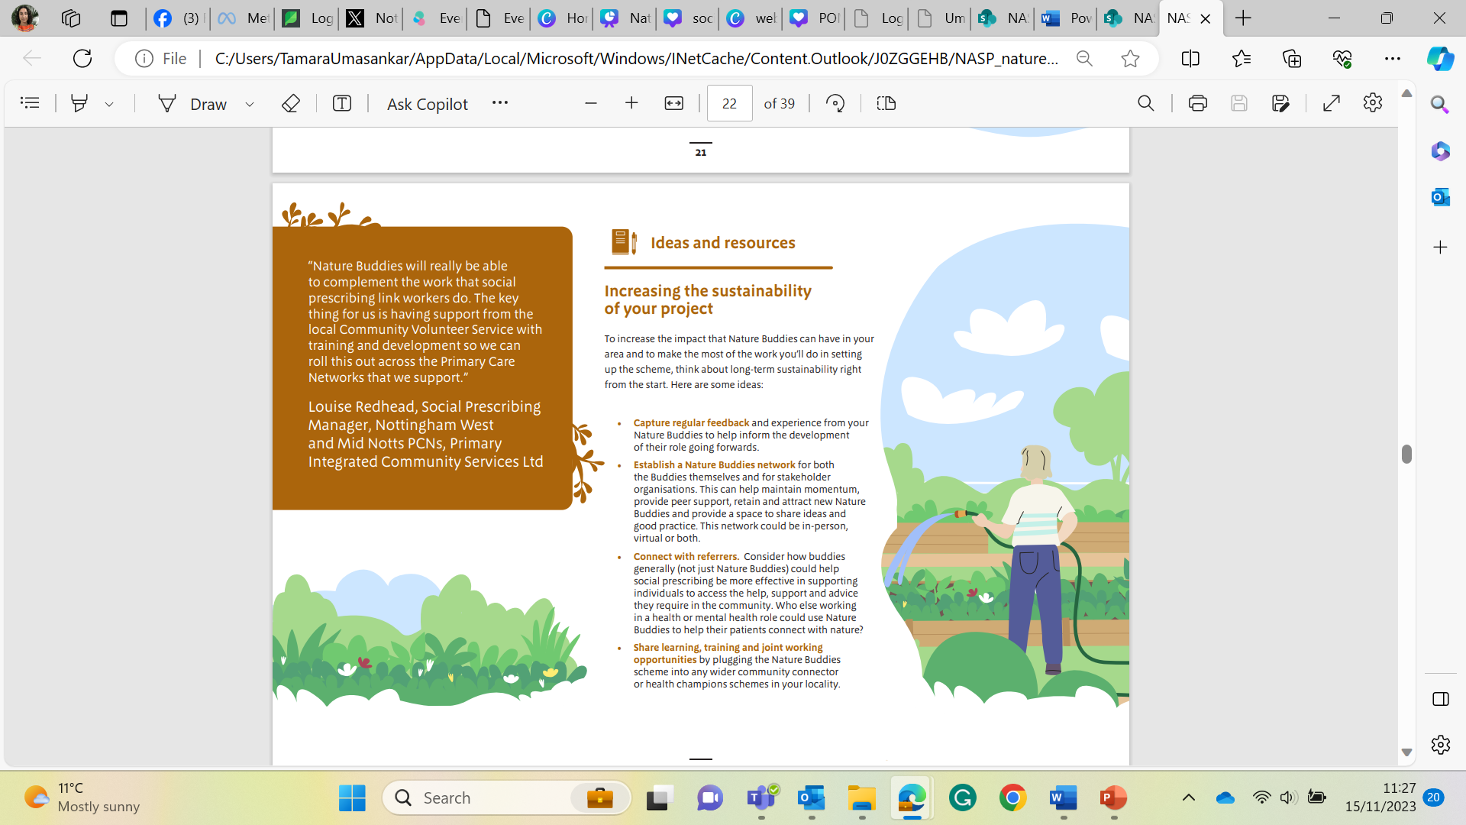
Nature Buddy
What’s in it for me?
  The chance to develop new friendships and skills, such as communication, mentoring, negotiating.
  You will feel part of making a meaningful difference to someone who needs your support.
  You will be given induction training into the various aspects of the role.
  You will receive ongoing training and peer support at regular volunteer and networking meetings.
  Develop your understanding of, and increase your connection to, the landscape, wildlife, history, culture.
  You will have access to a wealth of online resources.
  You will gain experience in the social care sector and environmental sector.
6

Slide 7

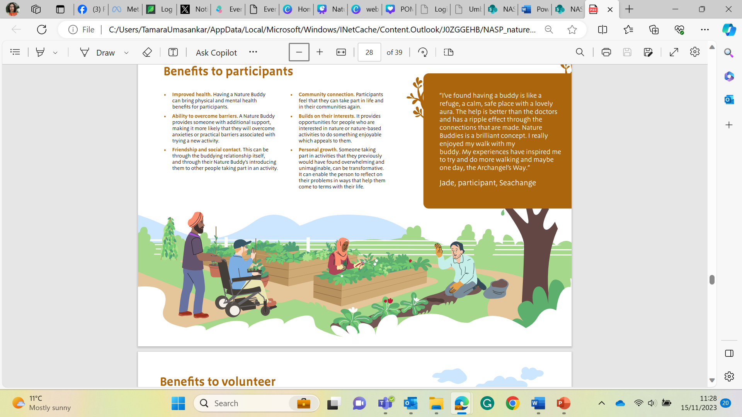
Nature Buddy
What makes a good buddy?
There are many qualities and characteristics that create a strong and valuable Nature Buddy.
Before we show you what we came up with what do you think these qualities could be?
7

Slide 8
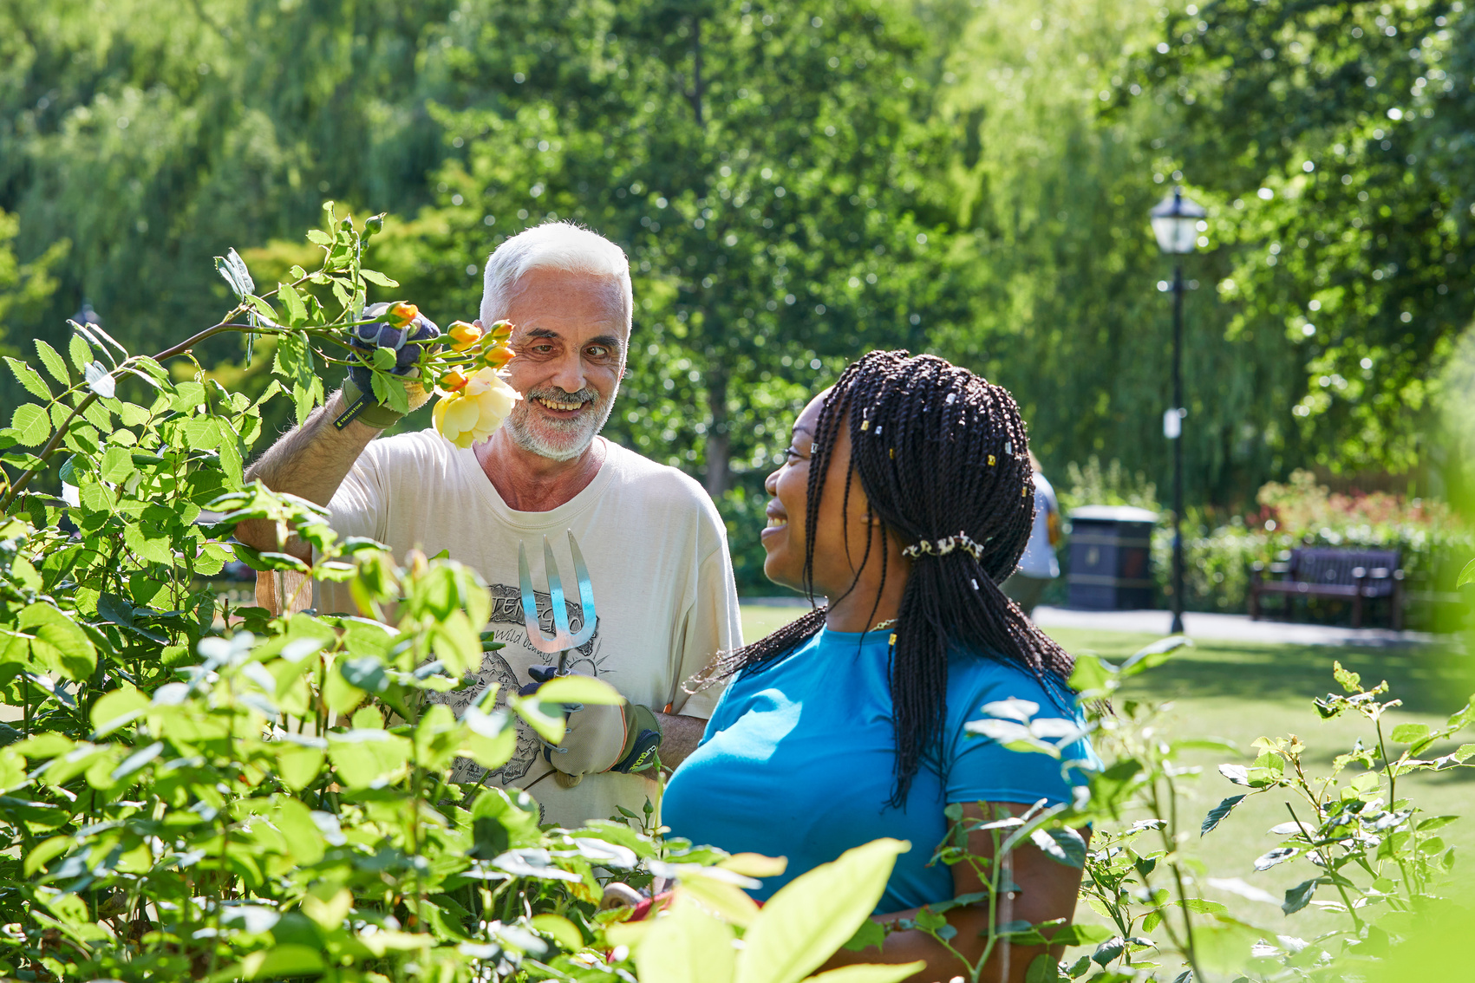
Nature Buddy
What makes a good buddy?
Here are some of the things that we believe are important qualities in a Nature Buddy.
  A real appreciation of and interest in nature and the outdoors (no expertise required)
  Strong listening skills
  Understanding of the service user/ client group
  Ability to approach new people or be approached without prejudice
  Honesty and trustworthiness
  Commitment and reliability
  Respect for confidentiality
  Friendliness and warmth
  Empathy and resilience
  Professional approach to volunteering with the organisation
  Ability to offer caring and understanding presence
8

Slide 9
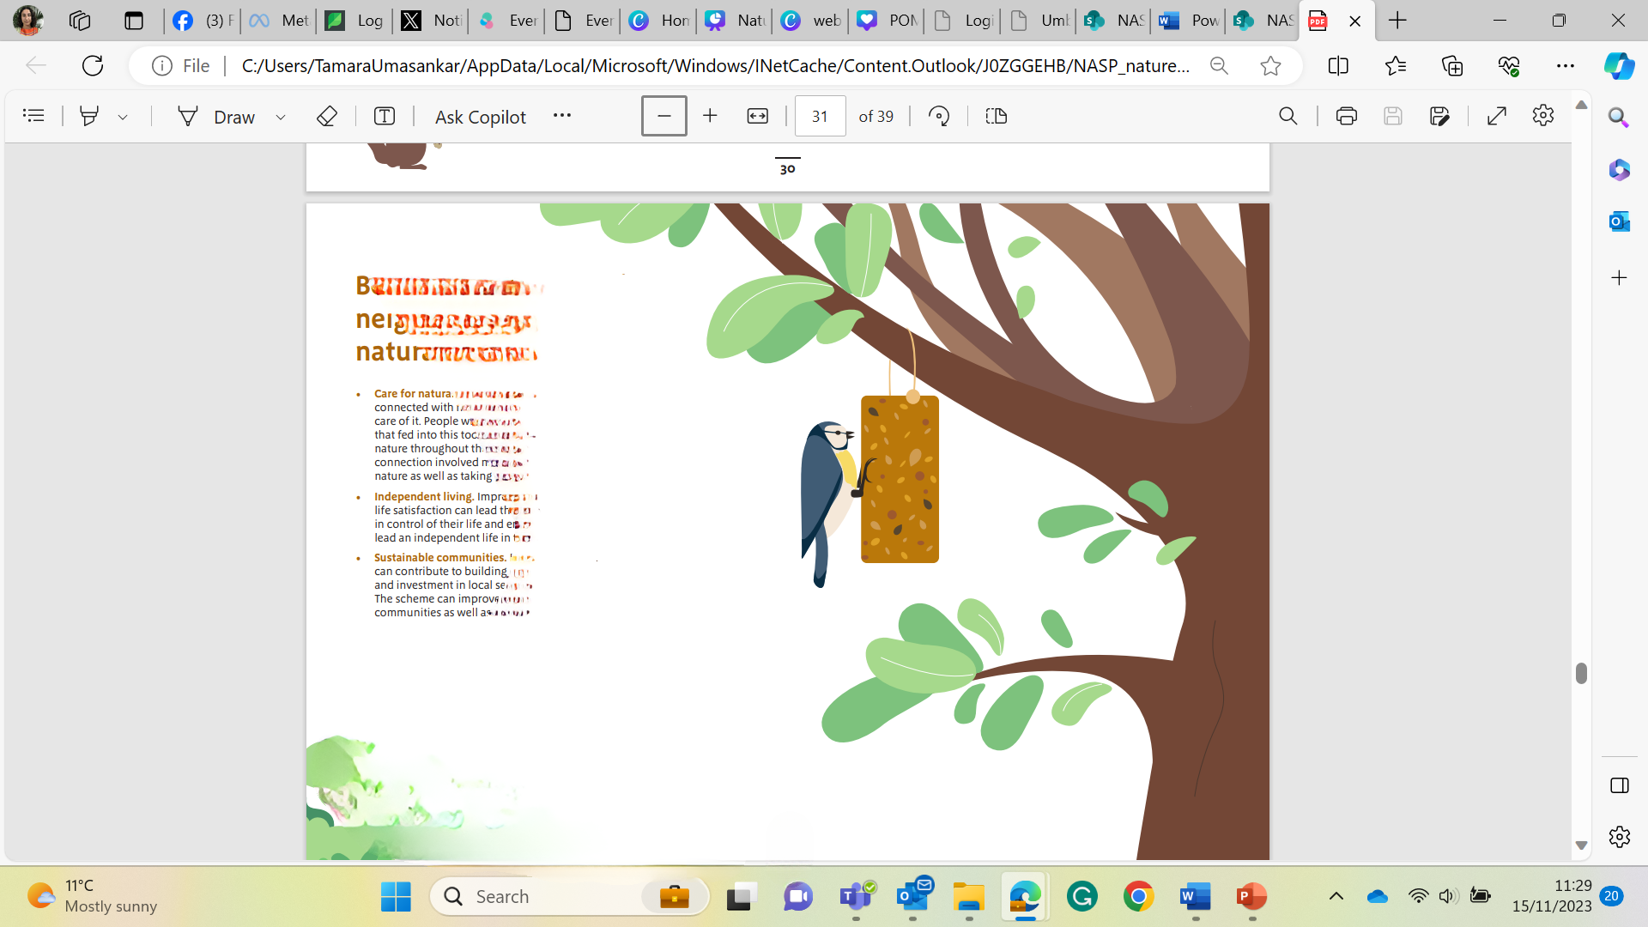
Nature Buddy
Why outside is good for you
The benefits of being outside include:
✔ Improved mental wellbeing
✔ Greater vitality and happiness
✔ More satisfied with life
✔ More pro-environmental behaviours
✔ More pro-nature conservation behaviours
✔ Greater meaning and purpose in life
9

Slide 10
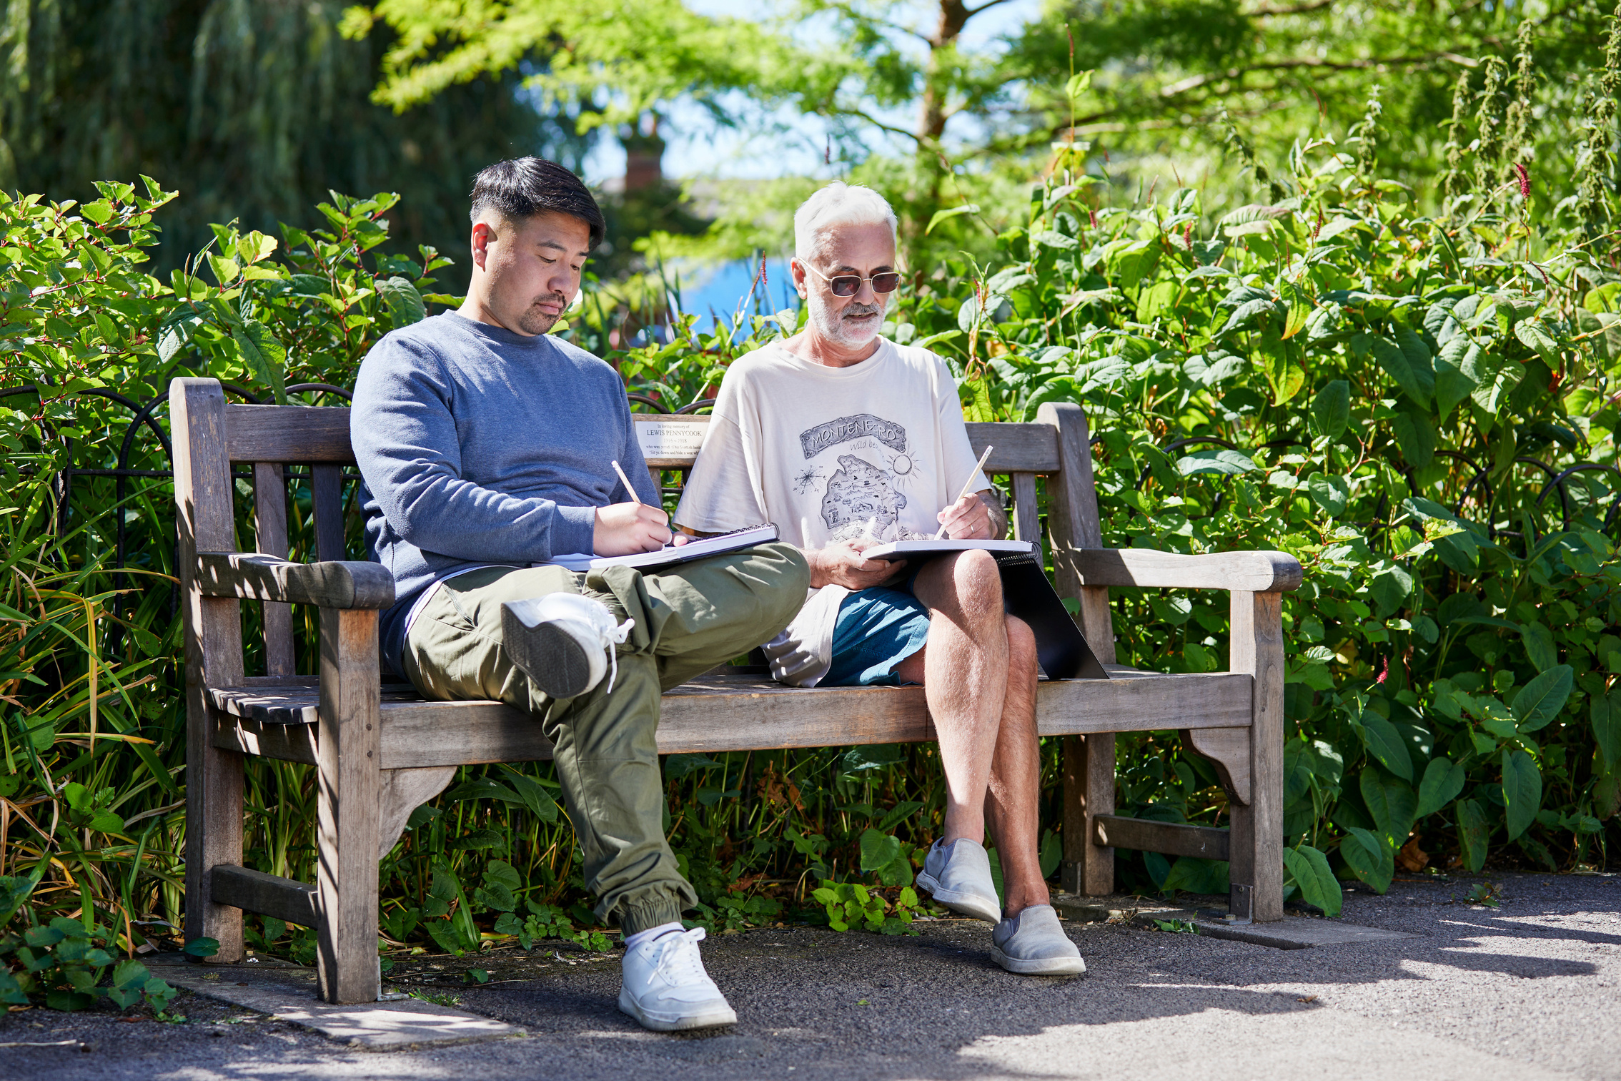
Nature Buddy Boundaries
Why do we need them? Boundaries set out our limits and expectations.
Some dos and don’ts to consider when navigating boundaries:
✔ Do recognise your own personal boundaries
✔ Do avoid getting into situations that could be misunderstood
✔ Do think before you say “yes” to a request for help
✔ Do remember that the main focus of the relationship is the needs and
progress of the other person
X Don’t give out your home telephone number or address
X Don’t take the other person to your own home
X Don’t become emotionally over-involved (this can be difficult)
If you are ever in doubt about a boundary issue, speak to the senior person running your activity session as soon as possible.
10

Slide 11


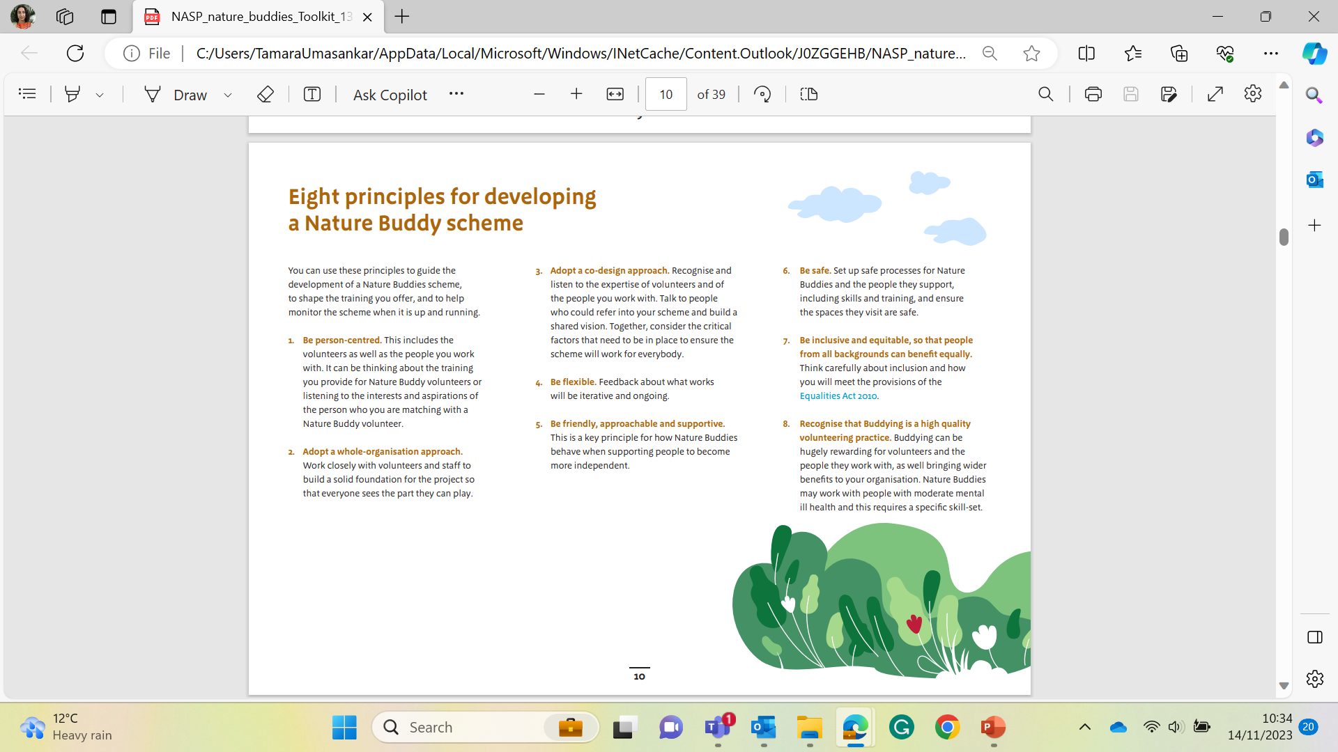
Nature Buddy Boundaries
Useful to Know:
You can hide your number for all phone calls by changing the caller ID settings in your phone.
To hide your phone number just for one call from most mobiles in the UK, dial 141 before dialing the number you want to call. This hides your caller ID*
*Dial 150 from an EE mobile
Always hide your number
slide to answer
11

Slide 12
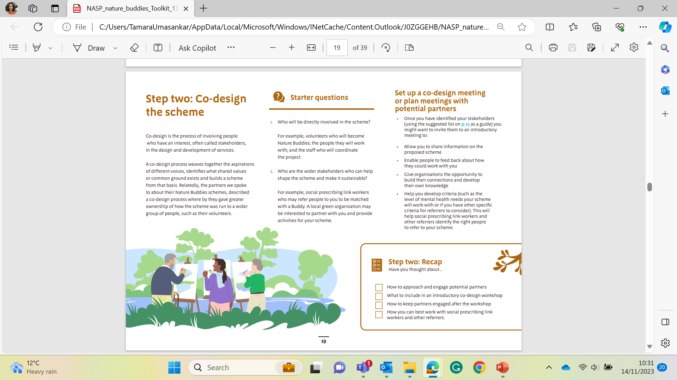
Nature Buddy
Boundaries: Self-disclosure
Self-disclosure means ‘opening up’ about your own personal experiences.
The skill is in deciding what and how much to reveal. Generally, good practice is to reveal only as much as is relevant and helpful within the context of what you are discussing with your client.
Here are some general guidelines to help you decide when and how to share personal information:
✔ Always be clear that your purpose is to help the other person express themselves more freely. When in doubt, don’t reveal anything.
✔ Keep it brief – focus on how you resolved a situation or how it felt, rather than talking about the detail
✔ Be careful that you don’t distort the overall balance of the relationship –the other person should remain at the centre and focus of the relationship, not you
Think of self-disclosure in terms to adding spice to a recipe: not too little, not too much, and if you’re not sure if it’s
appropriate then err on the side of caution and leave it out altogether!
12

Slide 13
Nature Buddy
Boundaries: Your involvement
Under Involved
Helpful Zone
Over Involved
13

Slide 14
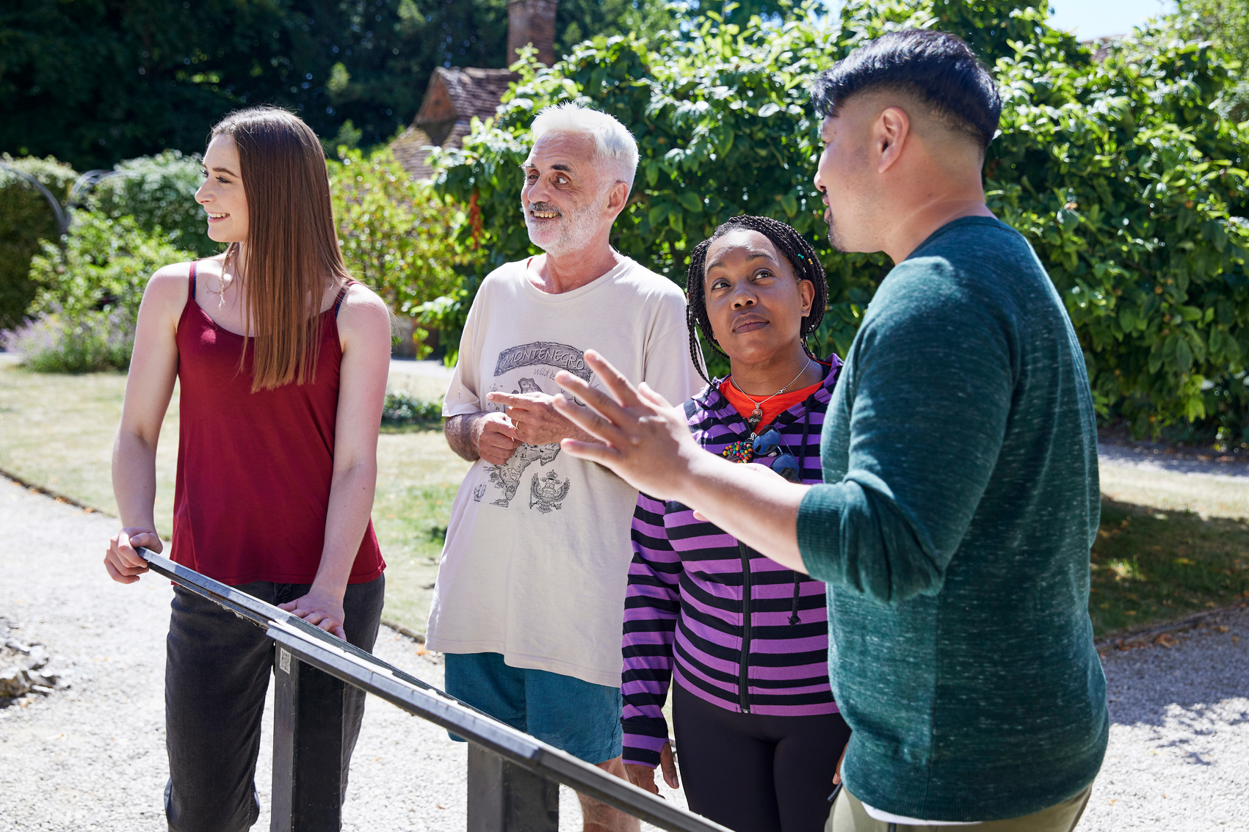
Nature Buddy
Boundaries: Demonstrating Acceptance
The first task of being a buddy is to develop a helping relationship where there is genuine acceptance. This means showing respect for and valuing the other person, even if you don’t always agree with their behaviours and attitudes.
Acceptance is demonstrated by:
  valuing the other person separately from their actions
  offering acceptance consistently and unconditionally
  respecting the other person’s separateness and unique qualities
  being aware of your own and the other person’s personal boundaries
  putting your own opinions, judgments and preconceptions to one side
  being able to accept yourself and acknowledge your own self worth
When the other person feels accepted, this helps them to:
  develop trust
  respect you and feel respected by you
  become more willing to share their experiences and feelings with you, and talk about difficult subjects or behaviours
  recognise that you have some understanding and insight of who they are and why they behave as they do
14

Slide 15
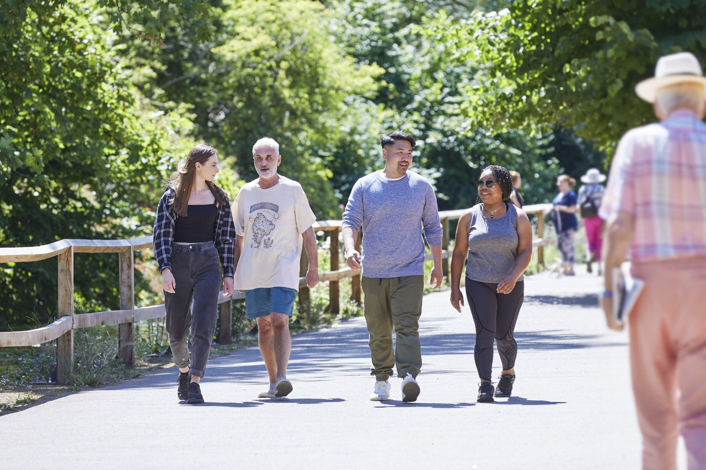
Nature Buddy
Safeguarding Overview: Adults
It is important to remember that, as a volunteer, it is not your role to deal directly with safeguarding issues. It is, however, your duty to know when and how to report any potential concerns.
Adult safeguarding duties under the Care Act 2014 [1] apply to an adult, aged 18 or over, who: Has needs for care and support and Is experiencing, or at risk of, abuse or neglect and as a result of those care and support needs, is unable to protect themselves from either the risk of, or the experience of, abuse or neglect.
People in this situation may be referred to as:
  adults with care and support needs
  adults at risk
  vulnerable adults
Your role is to:
✔ Prevent harm and reduce risk of abuse or neglect to adults
✔ Stop abuse and neglect wherever possible
✔ Support adults in making choices about how they want to live
Report anything that causes concern to the senior person running your activity session as soon as possible.
15

Slide 16

Nature Buddy
Safeguarding Overview: Children
The term 'children' means children and young people from birth to their 18th birthday
Why is this important, even if you do not volunteer with children?
Protecting children from harm is important in every day life because every child matters. If you only volunteer with adults, you need to be aware that those adults they may at some point disclose important information about children or even their own childhood.
It is important to know the following can all fall under safeguarding children:
  Online abuse
  Living in a home where there is domestic violence
  Being in an abusive relationship (young people)
  Female genital mutilation
  Radicalisation
  Physical abuse
  Neglect
  Emotional abuse
  Sexual abuse
  Bullying
Report anything that causes concern to the senior person running your activity session as soon as possible.
16

Slide 17

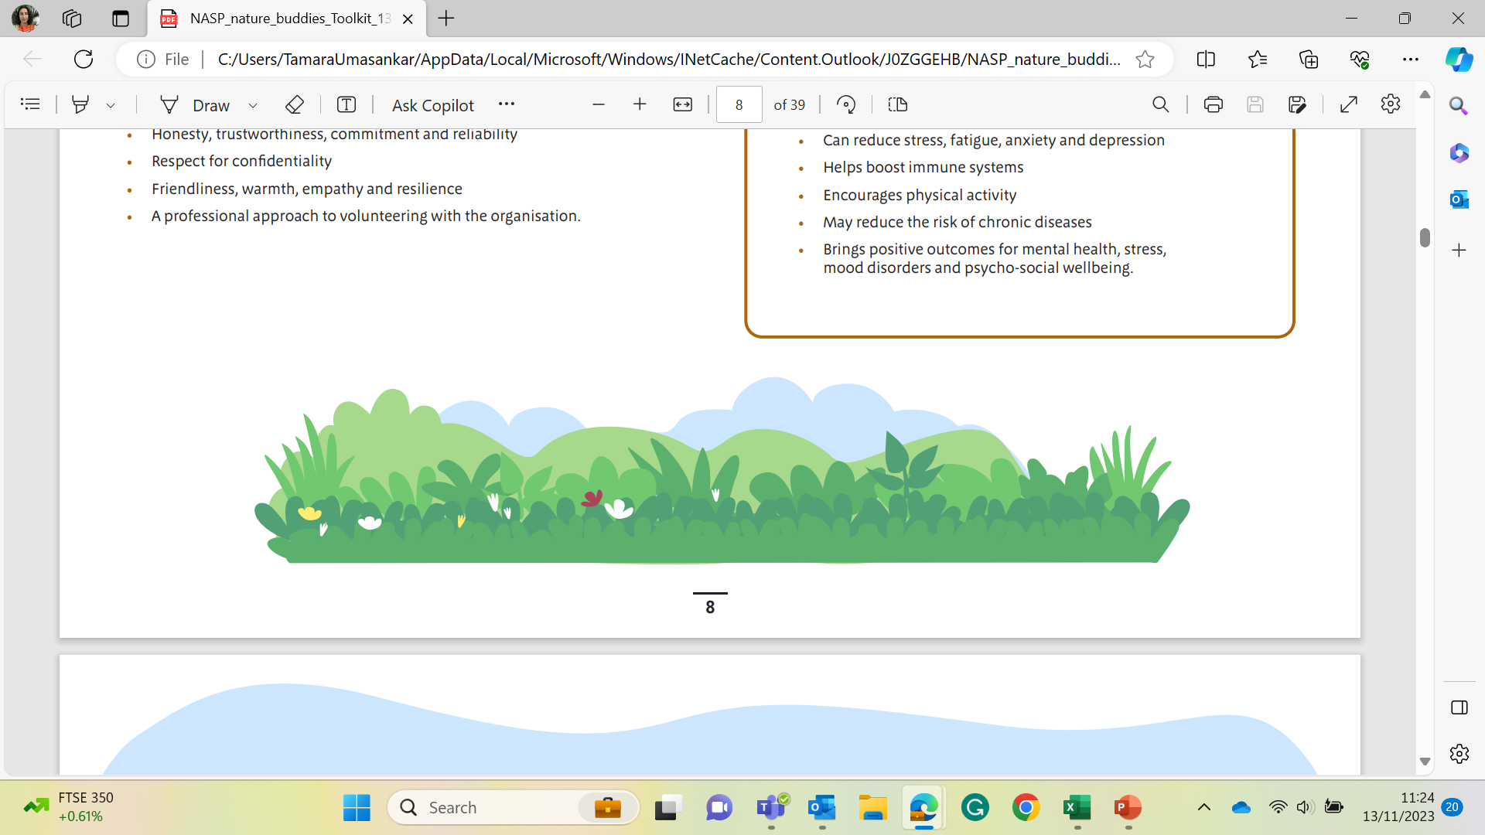
Nature Buddy
Online Training
Registering for E-learning for health:
As someone who is supporting people within your community who may be experiencing mental or physical ill health and may have been referred to your organisation to increase their wellbeing you can access the training freely available on the e-learning for health platform.
It is easy to register and access learning that will help support you in your role.
https://support.e-lfh.org.uk/get-started/registration/#1601
17

Slide 18
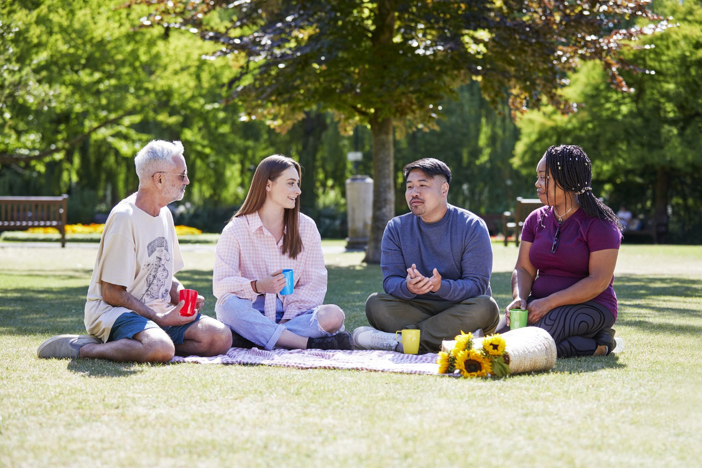
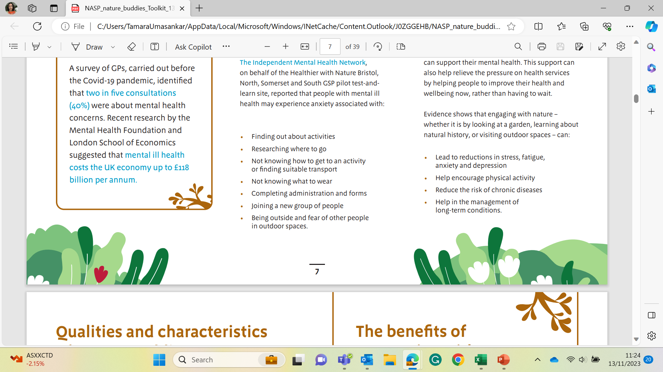
Nature Buddy
Pairing Up
Your organisation will pair you up with a member who you will buddy.
My client’s name is:
They will be attending:
(activity, dates times)
My aim is to support them to:
Useful to know:
Best way for me to get in contact:
18

Slide 19
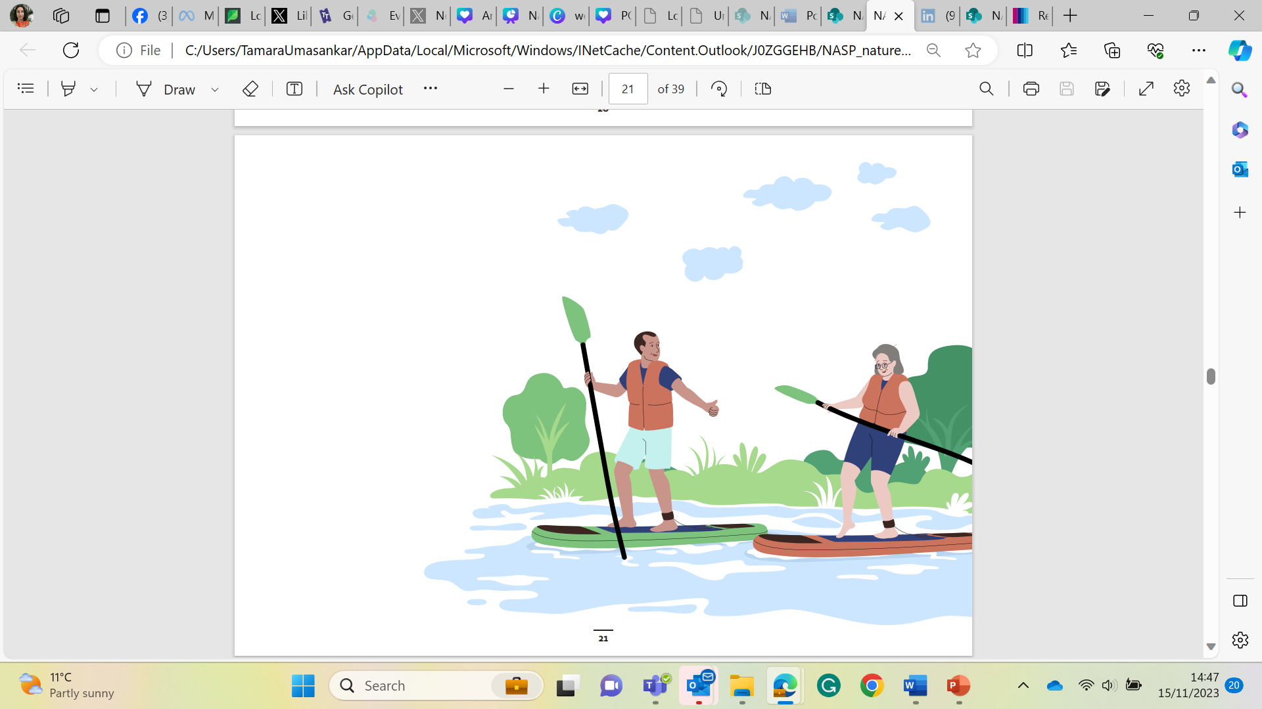

Nature Buddy
Goal Setting
Goals are so important but must be chosen wisely and in collaboration with your client.
The smaller the goal the more achievement can be gained.
The more achievement the more confidence builds.
You might have fabulous plans of where the client might be in a months time but they might just need to know where they need to be tomorrow, at what time and which bus to catch.
Start small and keep them
achieving.
The big goals will all come in time.
19

Slide 20
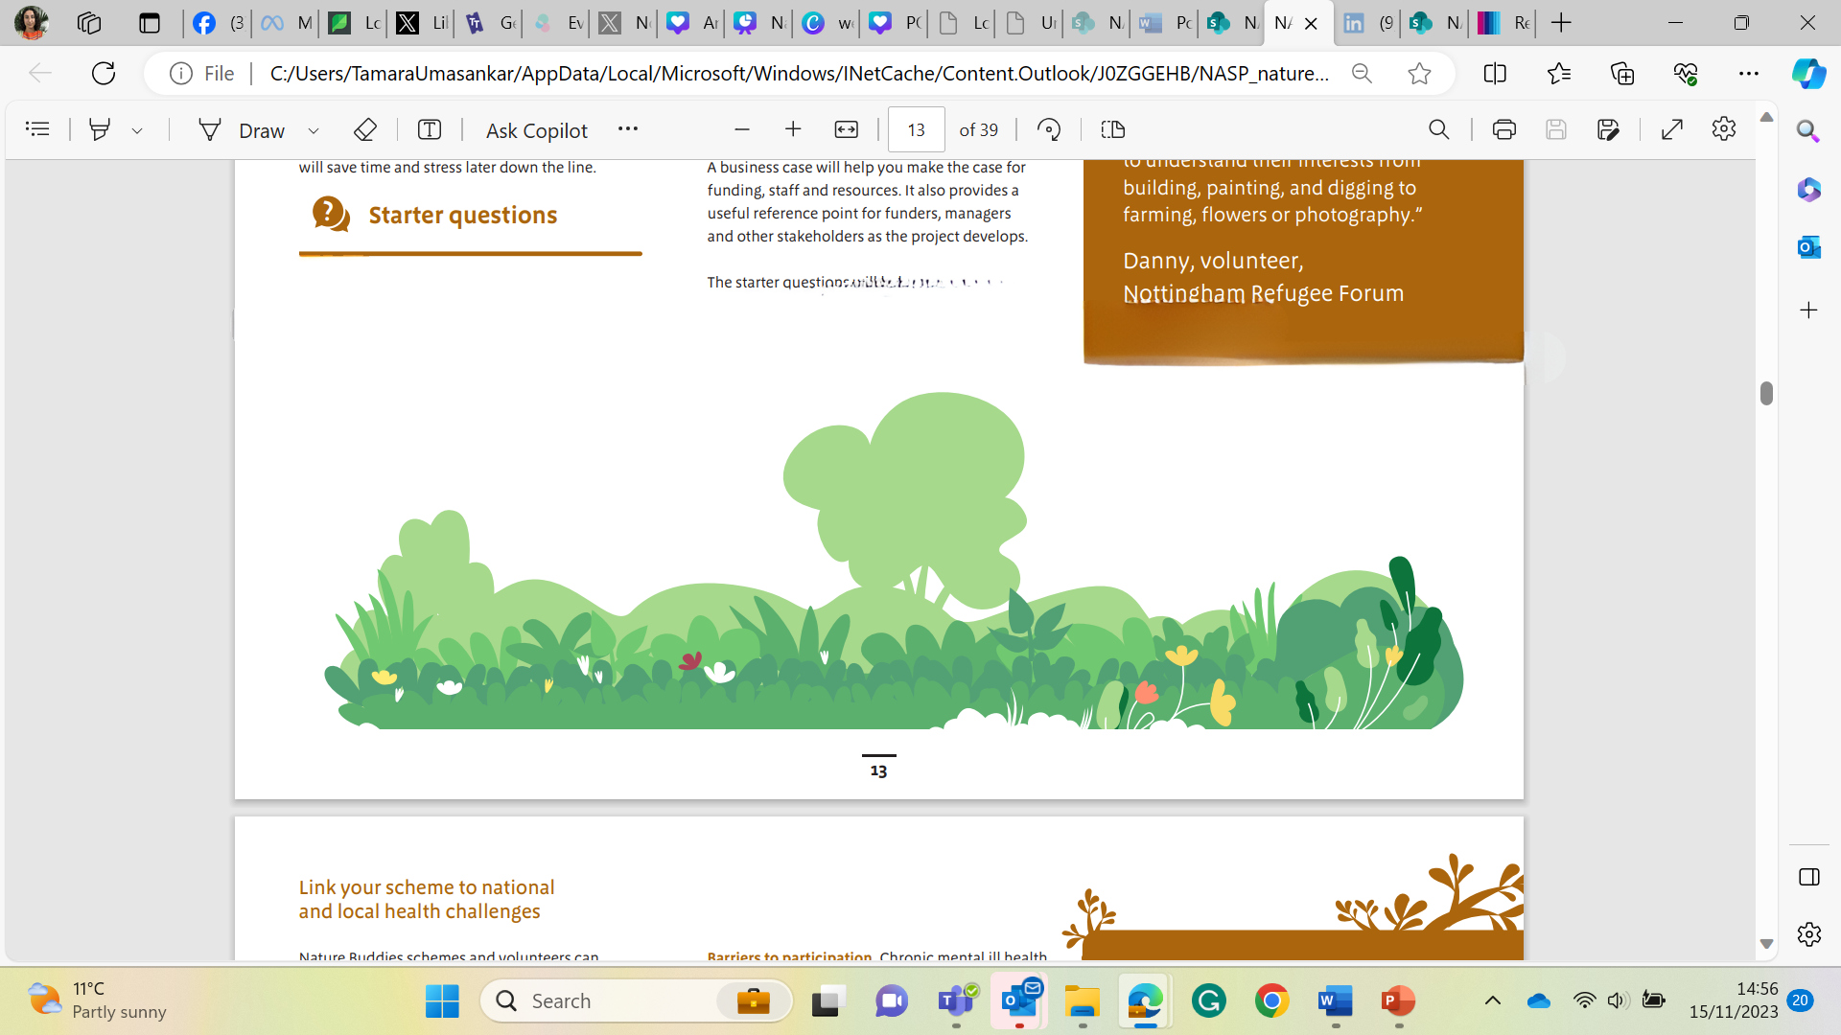
Supporting your buddy
Encourage, engage with and support your buddy
Engage
Support
Disengage
The Plan: Note down anything that you may find helpful to support your client. When you might see them, speak to them, any little goals that you might set together. Anything they might need to read, look at or prepare in advance to make things easier, such as flask of tea, a change of clothes, car park procedures, etc.
20

Slide 21
Urgent Mental Health Response
There may be a time when someone attending your group needs urgent support with their mental health. This can happen to anyone during their lifetime but knowing what to do to support them can really make a difference.
They may:
  Have harmed themselves and need medical attention
  Be having suicidal feelings, and feel they may act on them
  Be putting themselves or someone else at immediate, serious risk of harm.
If they are not safe by themselves: Stay with them and help them to call 999 or let others know and take them to A&E.
If they can keep themselves safe for a little while: You can help them to contact their GP or alternatively you can get quick medical advice by calling the NHS on 111. You can also encourage them to call the Samaritans on 116 123 or to contact one of the services detailed in the following pages.
If you or others feel in danger: Call 999 and ask the Police to help. You may be worried about getting the person in trouble, but it's important that you keep yourself and the other members of your group safe.
If applicable, please also contact the person who made the referral into your group to inform them of the situation.
Further places to signpost the person to are listed in the section on additional support in this booklet.
21

Slide 22
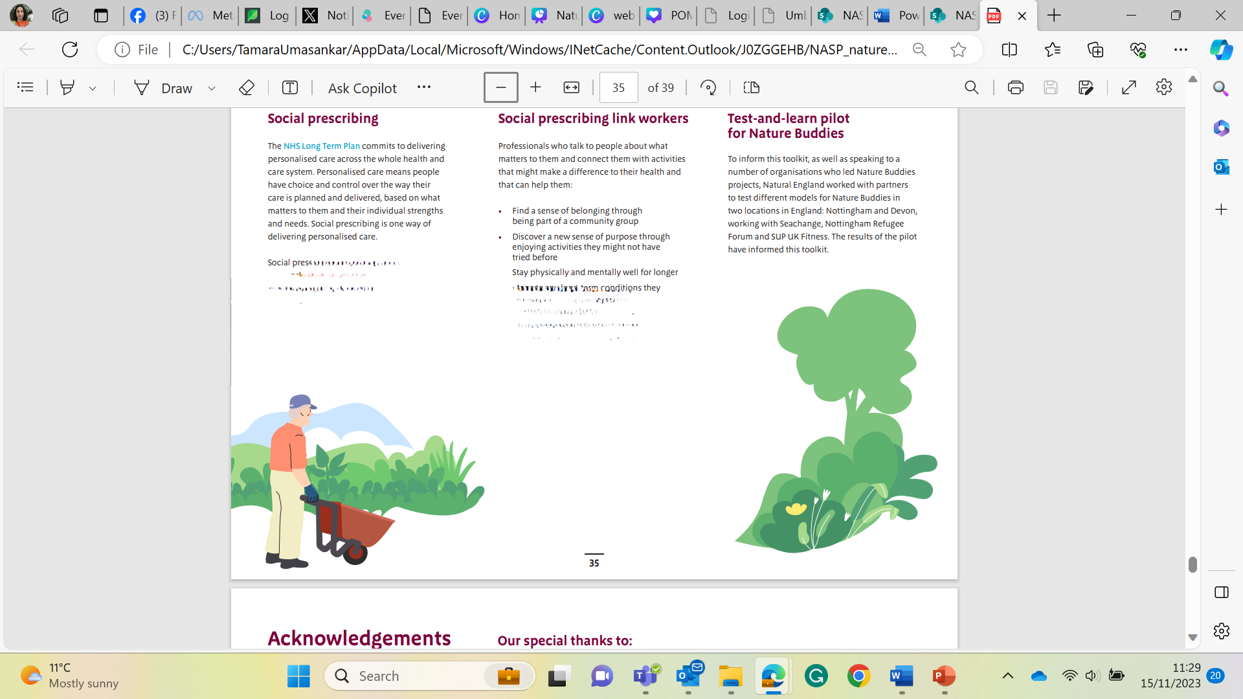
Nature Buddy
Feedback
Keep a record of how its going if you can even if it’s just one sentence on an app or in a notebook that will jog
your memory at a later date and help our research.
✔ This will help you to identify any patterns of behaviour.
✔ It will remind you of awesome memories
✔ It will help you to reflect when things don’t go to plan.
22

Slide 23
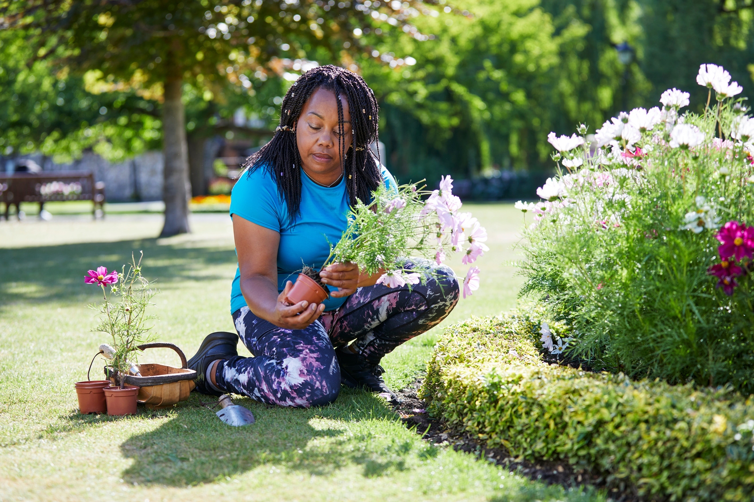






Sharing Success Stories and Case Studies
A set of numbers cannot fully describe the social and emotional impact of an experience, and so we would be really grateful if you would be prepared to share any stories, experiences and case studies with the GreenSpace team to demonstrate the effect that Nature buddies has on the individuals involved, whether that is from the perspective of a service user, or from someone within the organisation who is delivering the activities.
Case studies could be:
Video
Posts shared on a social media platforms
Audio recordings
Blogs/ Vlogs / Journals
Anything else that shares your experiences of nature buddies.
Photographs
23

Slide 24

This induction pack was created by

