Slide 1
NASP webinar: Improving Access to Social Prescribing through Care Navigation and Online Consultation
David Cowan, Thriving Communities Regional Lead Northeast & Yorkshire, VONNE
Tracey Burton, Practice Manager from Newsome Surgery Huddersfield and a Business Consultant.
Matthew Taylor, Managing Director, Sano Physiotherapy Ltd
Rebecca Scott, Social Prescribing Link Worker York Rd PCN
Catherine Joyce, Social Prescribing Link Worker York Rd PCN
Robynne Orton, Senior Social Prescribing Link Worker Hartlepool PCN

Slide 2
Housekeeping
Please note we are recording this webinar (you will be sent the slides and the link to the recording, and they will be on NASP's website too.)
Presentations, then a Q&A session at the end.
Please submit questions via the chat.
Please use the chat for introducing yourself and networking.
Please stay on mute and camera off.

Slide 3
Accessibility
Closed Captions are available – turn these on at the bottom
of your screen
BSL interpretation is available – the interpreters will be spotlit
Please put any technical questions into the chat

Slide 4
Overview of session
David Cowan, Thriving Communities Regional Lead Northeast & Yorkshire, VONNE
Tracey Burton, Senior Social Prescribing Link Worker Hartlepool PCN
Matthew Taylor, Managing Director, Sano Physiotherapy Ltd
Rebecca Scott and Catherine Joyce, Social Prescribing Link Workers York Rd PCN
Robynne Orton, Senior Social Prescribing Link Worker Hartlepool PCN
Q&A – 30 mins

Slide 5
David Cowan
Thriving Communities Regional Lead Northeast & Yorkshire
VONNE

Slide 6
The current ‘model’ of general practice
For patients the current ‘model’ is:
Confusing; things have changed and I’m not sure how it works now
Frustrating; the 8am rush, told to call back tomorrow
Worrying; will I get an appointment when I
need one
Unfair: first come first served allocation of appointments
Reflected in declining patient satisfaction with access
For practices and staff the current ‘model’
Carries a sustainability risk in the face of increasing demand-capacity gap and risk of staff burnout.
Carries an increased clinical risk from higher volumes and more complex patient needs.
Means we’re not able to see all demand and plan workload as effectively as we’d like.
Means we’re often not able to understand patient needs fully at the point of request.
Means we’re often not able to prioritise easily in a ‘first come first served’ approach
These challenges are unequally distributed (eg. practices in deprived areas feeling them more intensely).
4 |

Slide 7
The ‘new model of general practice’ supports practices to be fairer, safer and more sustainable
Objectives
See and understand all expressed demand and plan
Reduce avoidable appointments and support safer more equitable allocation of capacity
Make full use of a multi- professional team and improve the working environment
Process
Phone
Collect information
Enhanced information captured into online system. Request additional information or photos where needed to help remote closure
Filter
to remove
admin tasks
Signpost / Refer
Review, prioritise, allocate
including review for continuity of care
Online
to other services and information
Walk in
Intervention
Admin
Refer community
pharmacy
Remote close via message (eg. SMS)
Multi-professional
team
Self-serve
Refer to other primary or community services
Schedule consultation (phone or face to face) via SMS link or phone.
Refer to VCSE services

Slide 8
What is Active Signposting?
“Active Signposting is a person centred approach that uses signposting and information to help patients and their carers, move through the health and social care system as smoothly as possible”.
Often, patients do not need to see a GP first as there are many services that they may be able to access through self-referral, if they only knew about them.
Notes:
Jo

Slide 9
Why do we need Active Signposting?
GP Online reported in 2019 that over the four years to September 2019, the fulltime equivalent (FTE) GP workforce grew by 1.3%. However, they go on to say that this figure includes registrars, and rising numbers of GP trainees over the period conceals a 3.7% drop in fully qualified GPs. According to the recent data May 2023 (latest data) we now have the equivalent of 2,165 fewer fully qualified full-time GPs compared to the September 2015 baseline (when the current collection method began) (BMA, 2023). GP figures are now available for March 23.
There is an increasing number of patients to treat with the population of the UK estimated at 66 million mid-2017, its largest ever. The projected population surpasses 70 million in 2029 (ONS 2017).
Through the NHS Long Term Plan (2019), there is funding available to employ a widening workforce of allied healthcare professionals for practices who work together in Primary Care Networks (PCN), covering 30,000 to 50,000 patient populations.
NHS Digital reported that ‘there were 5,027 more qualified allied health professionals (FTE) in March 2017 compared to March 2010 an 8.51% increase.’
Notes:
Jo

Slide 10
Social Prescribing on the day demand
The increasing population combined with the decline in the number of GPs has – in some cases - resulted in overwhelmed GP surgeries, relied on for more than just healthcare. A report by Citizens Advice suggested that almost a fifth of GP appointment time is used for primarily social rather than medical problems.
Social prescribing helps reduce pressure on health and care services by referring patients seeking this kind of help to community based non-clinical services. However, many of these patients need to see a GP first, which uses up a clinical appointment for a non-medical need and requires two appointments for the patient, not one.

Slide 11
Capacity and Access Improvement
In previous years payments were made to PCNs for referral to Social Prescribing – Investment and Impact Fund (IIF)
ICBs and PCNs now use a Capacity and Access Improvement Payment (CAIP) template in their preparatory work for access improvement in financial year 2023/24. The starting point set out in the template will help to inform a decision by the ICB about the Capacity and Access Improvement Payment.

Slide 12
Policy Context
The new 2023/4 GP contract could help address this problem. It stipulates patients should be offered an assessment of need, or signposted to an appropriate service, at first contact with the practice.
70% of Primary Care Network (PCN) funding is now paid out to PCNs automatically monthly. The remaining 30% will go on access. This presents an opportunity for social prescribing teams to work with reception and through care navigation, improving access to social prescribing as long as demand is matched by capacity.
The NHS delivery plan for recovering access to primary care, lays out a plan for PCNs looking to do this and I have witnessed its benefits first hand in Newsome Surgery.

Slide 13
Tracey Burton
Practice Manager from Newsome Surgery Huddersfield and a Business Consultant.

Slide 14
IMPROVING ACCESS THROUGH SOCIAL PRESCRBING AND CARE NAVIGATION
Tracy Burton MIGPM

Slide 15
Introduction
I am Tracy Burton a Practice Manager from Newsome Surgery Huddersfield and a Business Consultant.
I have 19 years NHS Experience from Medical Receptionist, right up to Business Manager of a large GP Practice.
I am very passionate about good quality Practice Management and improving all aspects of Primary Care including patient safety, employee wellbeing and patients being able to access care “Right Place – Right Time”.
Though my passion and the NHS England Accelerate Program I have had the time to step back, look at the issues staff and the surgery were experiencing, and the lack of Care Navigation and Signposting was having a huge impact, so I decided late into 2022 to tackle this head on.

Slide 16
Primary goals
THROUGH THESE SLIDES I AIM TO:
Give brief details on the accelerate program
Let you know the problems I identified
Explain how I managed to onboard staff into making changes
Discuss frankly The persistence and grit needed
The results do speak for themselves AND To give you a sneaky peak we achieved a 15% saving per day of GP appointments, BECOME THE HIGHEST REFERERS INTO OUR SOCIAL PRESCRIBER SERVICE and as stress on employees went down, this also led to a 49% reduction in staff sickness.

Slide 17
NHS England Accelerate programme
There were 12 practice visits and 4 group based learning sessions.
The accelerate program was funded so allows back fill to get the time and space needed to tackle issues and for effective change management.
Support from the facilitator guided me through the program and allowed me to have to head space to tackle the issues the surgery was experiencing.
Support to accessing practice data if needed to identify your key issue areas.
Ongoing support via the Primary Care Improvement Community.
Do have a look on the PCIC. Connect Webspace for details of latest offers to practices.

Slide 18
What needs accomplishing?
I identified a lack of training for staff. This was having a huge impact:
Care Navigation was non-existent.
Appointments needed using more appropriately.
Staff moral needed improving.
Sickness rates needed to lower.
Staff needed less pressure so can start to see the wood from the trees again.
So Why?
There was no signposting as staff said “it was too hard” – this needed to change.
There were no consistent processes for reception work streams such as tasks so even simple tasks “were a battle” – protocols to follow were desperately needed.
Appointments were all gone by 9-9.30am everyday making answering the phones stressful.

Slide 19
Lack of active signposting
I developed a “Fit for Purpose” flow chart as National Care Navigation templates were too complex for my staff at that time.
Onboarding – vital! They needed to know why making changes so got onboard and embraced.
Change management is hard, so persistence and a tough skin helped.
Lead by example “I jumped on the phones. It’s about onboarding the staff – how you sell signposting to patients and how you sell it to staff”
Set realistic goals – “Just try to triage and signpost 2 a day as it will help”, but end we were at 12 signpostings per day minimum.
I provided live data on a fortnightly basis to show where we started and where we were. This really was a key turning point as motivated staff and encouraged them to do more.
I performed an appropriate appointment audit using my Accelerate facilitator which was alarming to see the lack of even basic signposting.

Slide 20
Scripts
“A social prescriber can help you better than a GP”
“Don’t be embarrassed everybody needs a little help sometimes and the social prescribers are lovely”
“The social prescribers have access to hundreds of voluntary organisations and charities so would be a good place to start for you”
“Have you considered you local community pharmacist they have years of experience in dealing with minor ailments and you will be able to get help sooner”

Slide 21
Negatives:
Met with massive staff resistance at first.
Took a lot of time to train staff and develop the support tools and flowcharts for them.
Confidence was slow to build.
Took a lot of my time.
But…………….

Slide 22
Average of 12 patients signposted per day. 15% GP time saving – I will show you how we calculated this shortly. Therefore more appointments for those who needed them.
We went from the lowest referring practice in our PCN to the highest within 2 months and I have some good patient success stories to come. Social prescribing referrals went up by a huge 10%.
Less stress on staff on the phones.
Aug 21-Jan 22 compared to Aug 22-Jan 23 – 49% reduction in sickness.
Staff moral massively improved.
We started with all appointments being gone at 9.30 am, now we usually don’t use the last till 11am and the odd day we have still had appointments at 2pm!
Patients now getting the Right Care – Right Time.

Slide 23
GP Time saved calculation
Signposts are recorded when a GP appointment has been saved;
Baseline of signposting at start of programme 0 per week
After two weeks following new process 8 signposts per day
Current average signposts 12 per day
12 signposts per day on average = 3,120 per year if maintained
Each signpost = 10 mins of GP time saved
3,120 x 10 mins = 520 GP hours saved per year
Whole Time Equivalent (WTE) GPs x 4 at Newsome Surgery x 5 GP sessions per day
At this surgery GP session = 2 hours 20 mins
Total GP sessions available at this surgery = 66 GP hours available per week x 52 weeks = 3,432 GP hours available per year at this surgery
520 hour saved is 15.15% of 3432 GP hours available per year. Potentially 15.15% of GP time saved at this practice through care navigation.

Slide 24
Success stories
Patient A – Had 3 children with eczema who couldn’t afford to replace her washing machine, so was washing clothes and bedding daily in her bath causing her back pain. Our social prescriber managed to connect her with a local charity and in under a week she had a washing machine improving the whole families lives.
Patient B – Was a 86 year old man who expressed his concerns to a receptionist had no phone and now his mobility bad how will he get help if needed as nobody to help him. (he was in tears at reception). Our receptionist signposted to our Social Prescriber and flagged as urgent and they managed to sort him a phone which is a huge safety line for him.
Patient C and D – A mum and daughter, and daughter was carer for her mum and had to give up uni. She was struggling financially and didn’t know what to do. As never had to handle finances before. She was referred into our social prescribers who not only helped her complete all the forms for benefits, but linked her with young carers support and got in touch with housing to make some safety improvements i.e. handrails and shower chair.
Patient E – My favourite……..

Slide 25
Reflection
You need the headspace and time to do projects like this as need persistence. I had tried when first started at my current surgery and failed as not enough time to do properly.
I should have kept notes of what worked well and what didn’t. On a few occasions made suggestions which had already crashed and burned.
The feedback to staff was vital in encouraging them and consider neurodiversity when presenting. Should have been done more often.
Developing scripts they could use as a tool to go to was a game changer.

Slide 26
Summary
I hope you have been able to see:
The importance of signposting but make it fit for purpose.
Small changes, can have huge impact.
Onboard your staff so know why.
Get involved and lead by example as it does work.
Get you social prescribers in to speak to the team. There passion was infections and helped staff see the benefits.
I really hope this inspires others to make change.

Slide 27
Mattew Taylor
Managing Director, Sano Physiotherapy Ltd

Slide 28
Care Navigation and Access​
​Matthew Taylor​
Managing Director
matt@sanophysiotherapy.com

Slide 29
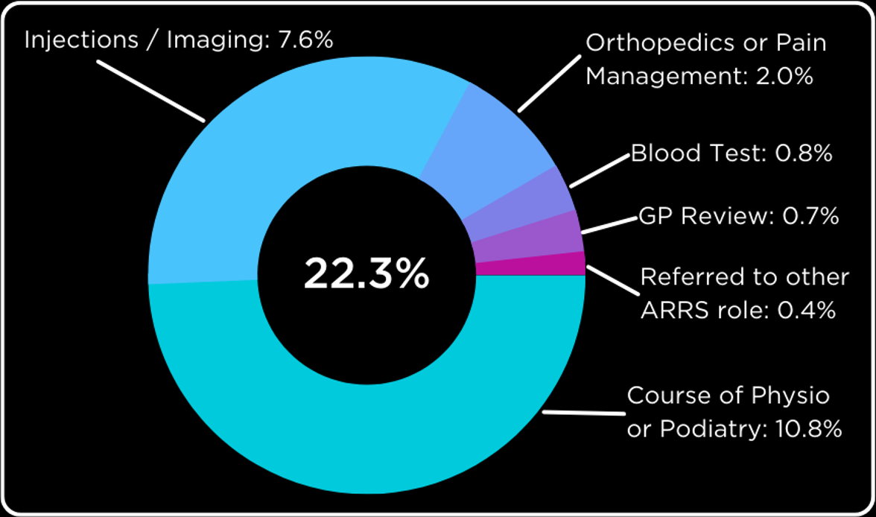
About
Sano Physiotherapy Ltd​
We deliver sustainable and data driven services:​
Monthly average utilisation across the whole of Sano's FCP services = 89.1% ​
77.7% of all patients referred into Sano’s FCP services self-manage their MSK condition in a single consultation
One of the largest employers of physiotherapists in the UK, outside the NHS,
Work with over 50 PCN’s across 13 ICB’s,
Deliver First Contact Practitioner (FCP) services under the ARRS and Enhanced Access hours on a national scale,
Offer flexible services to primary care and do not believe in a ‘one-size fits all’ approach to FCP services.
Self Management: 77.7%
Other: 22.3%

Slide 30
Care Navigation Tool
MSK patient
Do you have a problem with your neck, back, bones, joints or muscles?
No
Phone
Walk-in
Book
with
GP
or
another
ARRS
service
Yes
Are you currently under the care of a GP/Consultant/Surgeon for this specific issue?
Yes
Enhancing Access
Front of house
E-consult
No
Care Navigation
No
Are you feeling generally well at the moment?
Is the patient appropriate according to Care Navigation tool and exclusion criteria?
Yes
Are you happy to see our FCP for a consultation rather than the GP?
No
Yes
Yes
Book FCP
Offer patient Sano FCP service
Exclusion
Criteria
Acutely unwell,
House-bound (although now facilitated via remote consult),
Under 16 years old,
Require medical management of rheumatological conditions,
Require Women's health for antenatal/postnatal care
Require medication review for non-MSK conditions
Have neurological or respiratory conditions,
Headaches,
Acute mental health crisis,
Patients needing a physiotherapy appointment
Patients who do not want to see a FCP

Slide 31
Seamless integration – worked examples​
To highlight the different ways PCNs use our time/services to enhance patient access and seamlessly integrate with other systems​
Care navigation by front of house/E-consult:​
Our preferred method,​
If trained effectively, FOH can streamline access and book patients directly into our diary to ensure the patient sees the right practitioner at first contact, every time.​
Treatment model: ​
Effective care navigation essential,​
This model is proven to reduce referrals to secondary care MSK services (cost benefit),​
More patients are managed in-house (convenience for service user).​
FCP triage model:​
Admin heavy - multiple admin touch points between FOH, FCP and a Care Coordinator,​
Not as efficient as FOH care navigation,​
Unnecessary use of FCP clinical time.​

Slide 32
Summary and outcome data​
Effective FCP services require appropriate care navigation to ensure every patient is seeing the right practitioner in the right place, first time​.
Effective care navigation by non-clinical staff ensures:​
Patients receive MSK expertise without an unnecessary GP contact,​
Treatment pathways are streamlined,​
Fewer prescriptions and referrals for imaging and secondary care interventions are required,​
Patients receive timely preventative and rehabilitative interventions meaning fewer orthopaedic referrals are made, improving conversion rate to surgery, and​
More holistic health benefits​ are delivered by raising the awareness of other ARRS roles, such as social prescribing.
Service outcome data over the last 12 months:​
Access
Outcome
Feedback
97.4%
77.7%
95.1%
Of referrals were deemed ‘clinically appropriate’ for the service.
Of referrals were able to self-manage from a single FCP consultation​.
Of service users would choose to see an FCP again (rather than a GP) to manage their MSK condition​.
99.3%
92.8%
Of referrals were managed by the FCP without the need for a GP contact​.
Of referrals managed by FCP without secondary care, bloods or imaging​.

Slide 33
Rebecca Scott and Catherine Joyce
Social Prescribing Link Workers York Rd PCN

Slide 34
First contact Social Prescribing

Slide 35
Who we are and where we work
2 full-time Social Prescribers: Rebecca Scott & Catherine Joyce
Work across 3 GP practice covering 5 sites with a reach of approx. 38,000 patients
Part of York Road Primary Care Network (PCN) supporting individuals across East Leeds (LS9 & LS15)

Slide 36
Improving access to GP services
Improve access to social prescribing from the 'front door' at the GP practice.
Trialling of first contact social prescribing started June 2023 with just 1 practice
Rolling it out to our other 2 practices September 2023
Accessible appointments available within a 24-48 hour time frame for our reception team to utilise. Reception teams are assessing patient need on the phone and deciding if it would be appropriate for the social prescribing team – booking direct with the team rather than booking a GP appointment to then refer to the service
Creating diagrams of the topic areas covered within social prescribing, (housing, mental health, finances, social isolation, carers support, domestic violence) to name a few, to help our reception teams understand our role and direct patient phone calls for appropriate appointment type

Slide 37
How did we start the first contact slots?
First contact appointments are an additional appointment in our working day. Assessed current patient capacity and decided 1 extra slot per social prescriber per day to start
Providing 10 extra new patient social prescribing slots per week.
We now have 26 new patient slots available- providing a more accessible service
From starting first contact we are feeling confident it is working well with 1 practice so rolling it out to our other practices in September. Continuing to trial the number of slots needed to ensure accessibility but not to overwhelm the service
Worked with reception teams to ensure they are confident booking appointments direct from patient calls to reception – attending target meetings and discussing with office manager

Slide 38
Issues we have faced with first contact social prescribing
First contact slots being booked more than 48 hours in advance
Ensuring patients are being booked appropriately with social prescribing according to there need
Reception teams to confirm with patients if they need a GP appointment as well as social prescribing support and ensuring this is booked in one phone call to ensure pt is receiving access to appropriate services efficiently
We continue to work with reception teams to overcome issues and encourage open communication and questions to be asked if there is any confusion on best service to place the patient with.
Including speaking with the social prescribers if a call comes through needing urgent social prescribing- do we have flexibility to speak with the patient on that day if first contact slots are full

Slide 39
Staff wellbeing
York Road PCN, Leeds, West Yorkshire

Slide 40
Inspiration
We often focus so much on patient wellbeing that we are at risk of neglecting our own wellbeing, and we often see this with our surgery staff too
One of our registrar GPs held a staff wellbeing event (photo walk) and we were keen to continue this after she left.
We wanted to develop our SP service further, and hosting staff wellbeing events was a great way to do this
Notes:
We have been holding staff wellbeing sessions since the end of last year. One of the main reasons we were wanting to do this is because we all spend so much of our working day focusing on patient wellbeing, and primary care is often so busy that we are at risk of neglecting our own wellbeing – I feel like this affects everyone
A lovely registrar who was with us last year kick started the idea and held a photo walk event, where people took time away from their desks, took photos and they had a competition for the best photo. She left in February and we saw the impact this event had and were keen to keep it going
We're always looking for ways to build and develop our service, and holding these events was a great way to do this + adding to our practice

Slide 41
How we gained ideas
Anonymous surveys sent out to all staff
Chatting to staff
Researching other staff wellbeing initiatives
Notes:
Before we started organising events, we wanted to get a good idea of what people would like to see – we tried anonymous surveys, looking into other wellbeing initiative, discussing with service managers, and just talking to our colleagues – it's the kind of thing people bring up in conversation – and because we're well known in the surgeries, this works

Slide 42
How we plan and run a session
Get feedback from staff about what they'd like to see
Agree budget with finance manager
Give everybody a date and time for the event
Advertise around the surgery
Book room space if needed
Buy lunch, prizes, any other necessary purchases (e.g., massage therapist)
We rotate sessions around GP practices to ensure all practices can take part
Notes:
Use system one to notify everyone, and advertise around the surgery

Slide 43
Notes:
Here are some examples of posters we have used to advertise the events – we usually put these around the surgery. I like to keep them quite fun and colourful

Slide 44
Sessions held so far
Our first event in December 2022 was a Christmas quiz with prizes
Bake off events
Wellbeing massage with Phoenix workplace wellbeing
Notes:
Here are some examples of sessions we've held so far. We had massage therapists come from Phoenix Wellbeing for our last one and this went down REALLY well – we will definitely look at having them in future

Slide 45
Issues we've faced
Unexpected costs such as room hire
Finding a date and time suitable for majority of staff (they are busy!)
Working with budget constraints, for example our budget for the last session only allowed 2 massage therapists to attend
Working around our clinics and putting time aside to organise events
Notes:
As it often does, the issues come down to time and money. Unexpected costs – food costs are typically low but we had a room booked a couple of times, and after that it turned out that we had to pay for any future bookings, so we've had to consider this
Re: date and time, we held one event during TARGET, if you're not based in GP surgeries this is training the surgeries do every month and they close, so everyone is in one place at same time, and we are looking at maybe holding more events around that time to help maximise attendance. We are trying to alternate event dates to help ensure more people can attend

Slide 46
Robynne Orton
Senior Social Prescribing Link Worker Hartlepool PCN

Slide 47
Improving Access to Social Prescribing through online consultations (e-Consult)
Robynne Orton Senior Social Prescribing Link Worker Hartlepool PCN

Slide 48
How did you identify an opportunity for improvement?
As a locality Team (Hartlepool and Stockton) we found that external referrals (including self referrals) needed a standardised approach because;
different versions of referral forms were being used
different link workers were receiving email referrals for patients not registered with their PCN (breach of data)
self-referrals were being done through Facebook Messenger where not all surgeries/link workers had access to it (also not appropriate)
different PCNs offered different ARRS roles and third party organisations did not know which surgery offered what role(s)

Slide 49
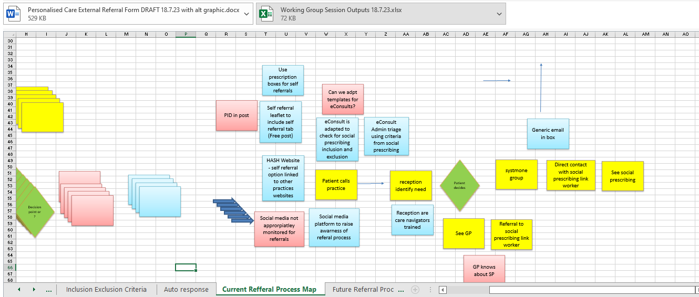
How did you identify an opportunity for improvement?
As a collective working group, we met regularly to develop a pathway. We suggested potential ways to access ARRS roles/support.

Slide 50
How did you identify an opportunity for improvement?
One of the suggestions from the working group was referrals to be done through e-Consult:
Evidence has shown in some recent pilot studies that if used more widely, e-Consult could help reduce waiting times significantly, in both primary and secondary care, as well as improving equitable access to specialist care
It can help educate the patient about the different types of care and support is available to them
Reduce unnecessary pressures of Clinicians
Promote appropriate use of appointments
Empower patients to take grater control of the support they feel they need
Offers a central point of access through a channel that many people are already familiar with
(Nabelsi, V. et al. 2019).

Slide 51
What steps have you taken?
The group agreed that this was a good idea to explore further.
The next steps included:
Speaking the with PCN Digital Lead to get feedback – is this a good idea from a Practice perspective?
Find out if the e-Consult form templates are created by individual practices or is it a standardised form used by all?
Find out the company who manages e-Consult
Check if the e-Consult template can be adapted to check for Social Prescribing inclusion and exclusion criteria

Slide 52
PCN Digital Lead agreed that it was a good idea
Individual Practice cannot adapt/change the templates including for Social Prescribing
Advised to speak to practice.support@econsult.health

Slide 53
What are the barriers?
A response was received that explained that although “it sounds like a great idea, we are not going to explore it any further I’m afraid.”.

Slide 54
What are the barriers?
Clinical decision making – can risk be clearly assessed?
e-Consult to SP is dependent on skills and knowledge of staff carrying out Care Navigation of the e-Consults
e-Consults are only open between 9am-11am in Hartlepool PCN
Social Prescribing Service Capacity to respond within the time limit provided as generic response to patients upon completion of the form
e-Consult requires more administrative work – do Admin Team have capacity?
Digitally excluded patients unable to access
Surgeries need to be clear on what cohort(s) they are wanting to target with e-Consult

Slide 55
Case Study
Female patient, aged 34, single mum to two children. Requested an appointment via e-consult. The e-Consult stated she had feelings/symptoms of anxiety and depression, due to family breakdown (due to domestic abuse) and is going through family court. She was requesting a not-fit for work due to DWP requesting she looked for work. She stated she did not want medication on the e-Consult. She also wanted help to move properties as she lived close to the perpetrator and his family.
Patient was given a telephone appointment with GP and after a “lengthy” telephone consultation he identified that there was no clinical need (as she did not want medication or referral to IAPT) and made a referral to Social Prescribing.
Notes:
The e-Consult form asks if the patient has any intentions to harm self or others etc.
E-Consult also asks if the patient has an idea of what support they need.

Slide 56
Patient’s journey to accessing social prescribing
Patient Accesses e-Consult service
Admin (Care Navigation) looks through e-Consult
Makes GP Telephone Appointment for patient
GP has 28 minute telephone call with patient
GP Refers to SPLW Team via task and is added to 4 week waiting list
GP also refers to Mental Health Practitioner
SPLW contacts patient and invites into surgery for F2F appt (1hr)
MHP completes 20 min appt and discharges as “there is no current role for specialist mental health practitioner” and feels SP is more appropriate
Identified Issues:
Housing
Relationship breakdown
Employment/Benefits
Possible Parenting Support
Notes:
The GP referred the patient to SP Team and Mental Health Practitioner. She was added to SP waiting list, contacted, invited in to surgery for (1hr) face to face appt with Link Worker and an 20 minute appt was given with the MHP (who subsequently discharged as she too felt there was no clinical need at the time of consultation).
By this time, she had told her story on 4 occasions:
Reception
GP
Link Worker
MHP
Link worker interventions included based on patients goals and needs:
Referral to in-house DWP Work Coach (as patient did not feel she could work at present and wanted support with how to manage the Job Centre) and to discuss possibly accessing local benefits agency to check benefits entitlement, whilst she is out of work.
Referral to local women’s wellbeing group as she was very isolated due to her family living out of area
Referral to local community café who provided safe activities for her children during the upcoming six weeks holidays
Supported to attend local Housing Advice Drop in, in the Civic Centre to get help with housing
*Patient had already had involvement with local domestic abuse organisation but did not feel well supported by them and declined another referral*

Slide 57
Improved patient access to Social Prescribing
Hartlepool PCN work on a 10-minute face to face appointment and a 5-minute telephone appointment basis. On average it takes 2.5 minutes to work through an e-Consult, which means twice as more patients can be helped in the time spent using traditional times of face to face and telephone.
However, on this occasion, with case study patient, the GP was on the telephone for 28 minutes, for there to be no clinical need for the GP and a referral (sent via task on S1) to be sent to SP Team and to MHP
Could this patient have been referred directly to SP without the need for GP appt through choosing the support she felt she needed?
By analysing the data collected on e-Consult access, e-Consults could be designed specifically for patients and clinicians/ARRS roles

Slide 58
What’s the desired outcome?
To utilise more of the non-clinical ARRS roles within Primary Care via Care Navigation and online consultations (e-Consult).
The eConsult service has already proven its ability to deliver better population health (e.g., improved access to specialist advice, reduced specialist visits), an improved patient experience of care (e.g., increased patient satisfaction), increased provider satisfaction (e.g., reports of educational value), and lower costs (e.g., lower per capita cost of eConsult vs. in-person specialist visit)

Slide 59
Ideal outcome... For now?
An e-Consult pilot project to assess and measure if access to Social Prescribing improves

Slide 60
Any Questions?

Slide 61
Get in touch
socialprescribingacademy.org.uk
@NASPTweets
@NASP_insta

