Slide 1
NASP International Webinar: How Clinicians Can be Agents of Change
Dr Meena Brewster (US)
Dr James Ibrahim (AUS)
Prof. Kheng Hock Lee (Singapore)

Slide 2
Housekeeping
Please note we are recording this webinar. You will be sent the slides and the link to the recording, and they will be on NASP's website, too.
Presentations, then a Q&A session at the end.
Please submit questions via the chat.
Please use the chat for introducing yourself and networking.
Please stay on mute and camera off.

Slide 3
Accessibility
Closed Captions are available – turn these on at the bottom of your screen
BSL interpretation is available – the interpreters will be spotlit
Please put any technical questions into the chat

Slide 4
Overview of Session
Chair: Sonia Hsiung – Director of the Canadian Institute for Social Prescribing (CISP)
Dr Meena Brewster – Social Prescribing: Leveraging Partnerships and Technology
Dr James Ibrahim – Insights from a GP Social prescribing in Australia
Prof. Kheng Hock Lee – Social Prescribing & Family Medicine for a Healthier Population
Q&A session – 30 minutes

Slide 5
Dr Meena Brewster
MD, MPH, FAAFP
County Health Officer, St. Mary’s County, Maryland, USA

Slide 7
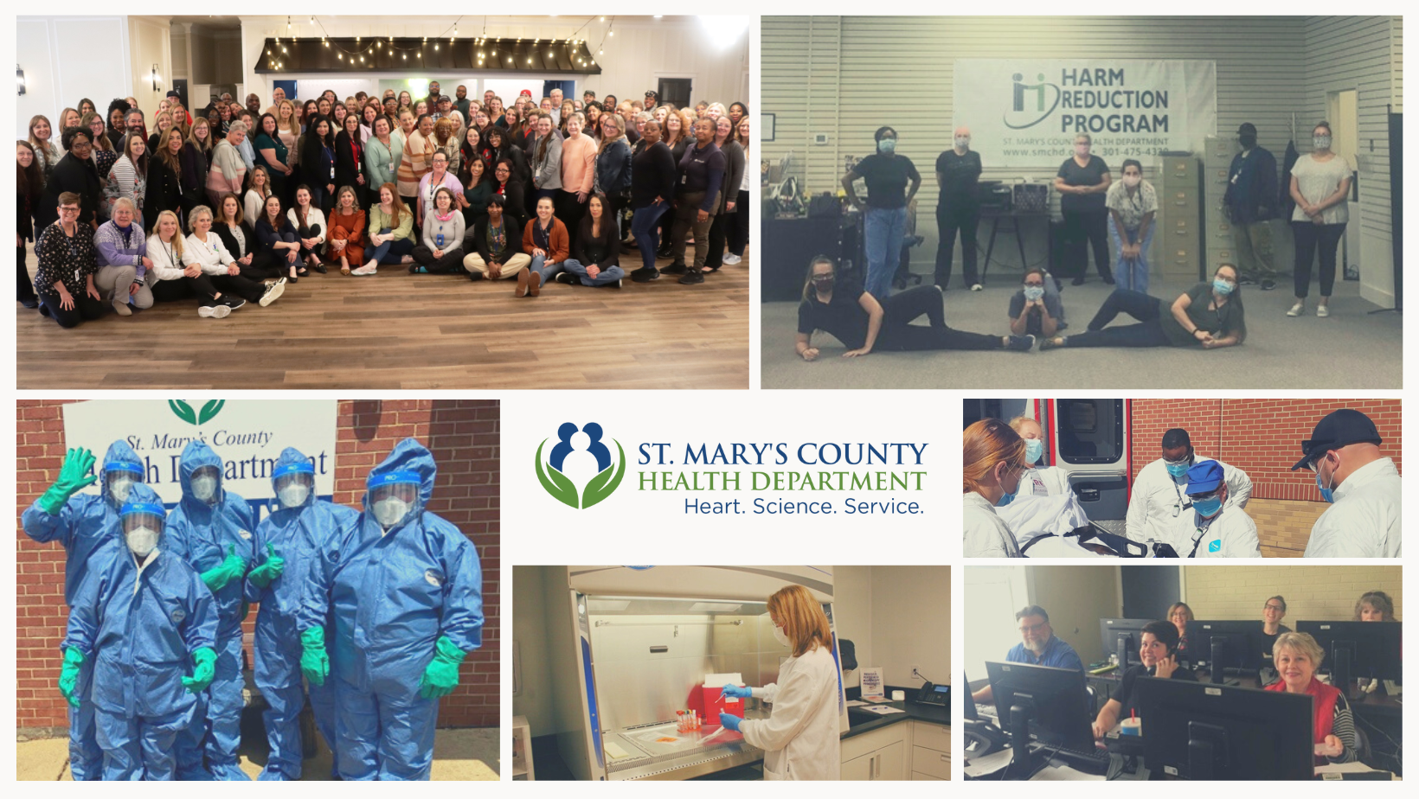
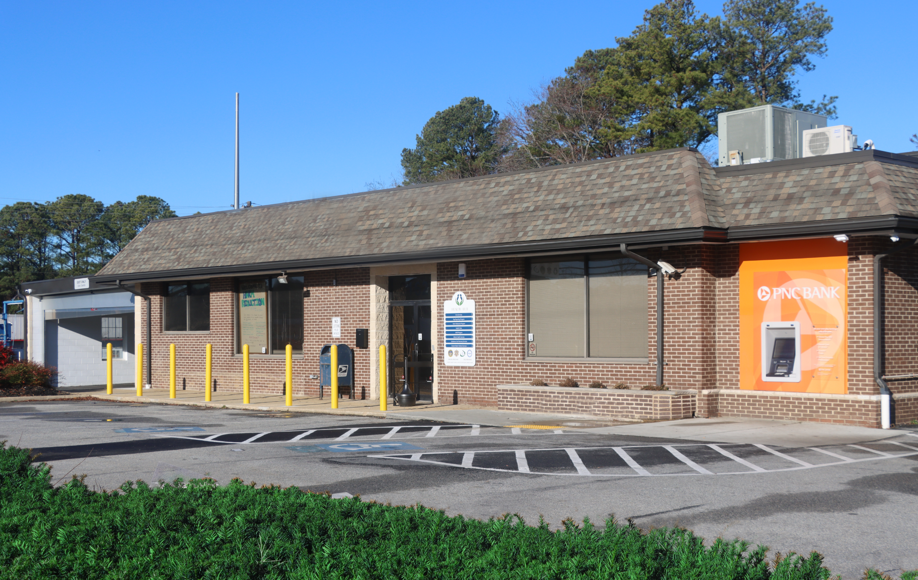
smchd.org

Slide 8
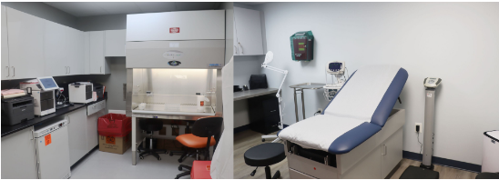
Health Hub - smchd.org/hub
◾ Behavioral Health Crisis Walk-In ◾ Harm Reduction ◾ STI Testing ◾ Wound Care
◾ Jail Diversion Program ◾ Primary Care Clinic ◾ Youth Mentoring ◾ Housing Supports
◾ Financial Coaching ◾ Conflict Resolution ◾ Legal Services ◾ Literacy Tutoring
◾ COVID-19 Testing ◾ Care Coordination ◾ Job Support Services

Slide 9
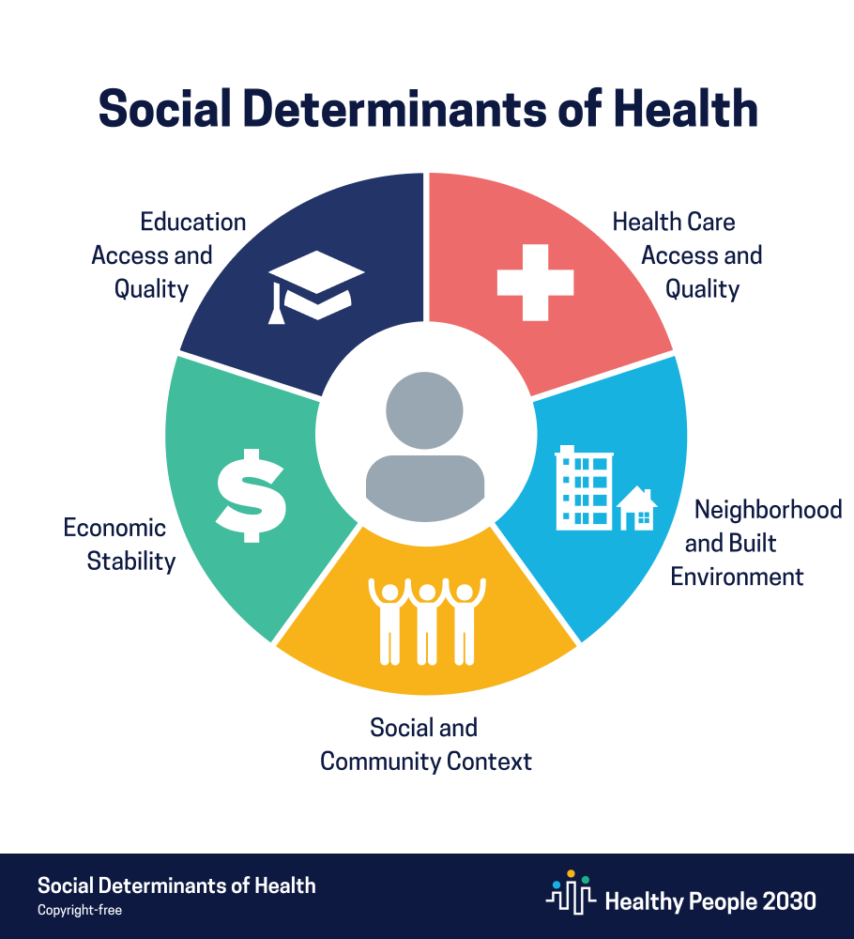
Social Prescribing at the Hub
Health Care Access
Behavioral Health crisis
Primary care
Infection control
Economic Stability/Work
Employment support services
Financial classes/coaching
Entrepreneurial support
Social and Community Context
Mediation services
Anger management classes
Conflict resolution coaching
Jail diversion programming
Youth mentoring
Legal expungement
Education
Literacy tutoring
GRE support

Slide 10
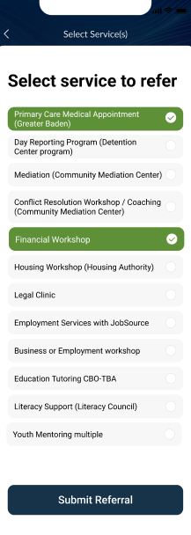
Digital Connective Tissue
Registration & Check-In
Across multiple service providers
Any digital device
No downloads required
Directory of Community Services
Time efficient
User-friendly
Browse descriptions & availability
Social Prescribing (made easy!)
Prescribed or self-referral
Prescriber notes & mark special needs
Scheduling mechanism
“Closed loop” feedback to prescribing clinician/provider
Automated reminders to participants
“Social Wellness” Assessment & Care Coordination
Consent & Confidentiality
Aggregate Data for Evaluation
wellcheck.us

Slide 11
Connect for More Info
Meena Brewster, County Health Officer
St. Mary’s County, Maryland, USA
meenakshi.brewster@maryland.gov
smchd.org

Slide 12
Dr James Ibrahim
MBBS, Mmedicine (Pain Management), Gdip (Psychiatric Medicine), FRACGP
Medical Director, Principal | Terrey Hills Medical Centre
Expert Panel Chair | Social Prescribing Institute of Research and Education (ASPIRE)
Clinical Lead | Alcohol and other Drugs, Sydney North Primary Health Network
Clinical Advisory Council | Sydney North Primary Health Network
GP Representative, Regional Leadership Group | Sydney North Primary Health Network

Slide 13
Insights from a GP Social prescribing in Australia
Dr James Ibrahim
MBBS, MMedicine(Pain Management), GDip(Psychiatric Medicine), FRACGP
Medical Director, Principal | Terrey Hills Medical Centre
Expert Panel Chair | Social Prescribing Institute of Research and Education (ASPIRE)
Clinical Lead | Alcohol and other Drugs, Sydney North Primary Health Network
Clinical Advisory Council | Sydney North Primary Health Network
GP Representative, Regional Leadership Group | Sydney North Primary Health Network
I acknowledge the traditional custodians of the various lands on which we meet today.
I pay respect to elders past and present and emerging.
I acknowledge their custodianship of this beautiful country.
I am inspired by the value they have placed on identity, country, culture and community.
I would also like to acknowledge and value the life journeys, struggles and successes of all those who invite us into their lives and all those who live without support in the community.

Slide 14
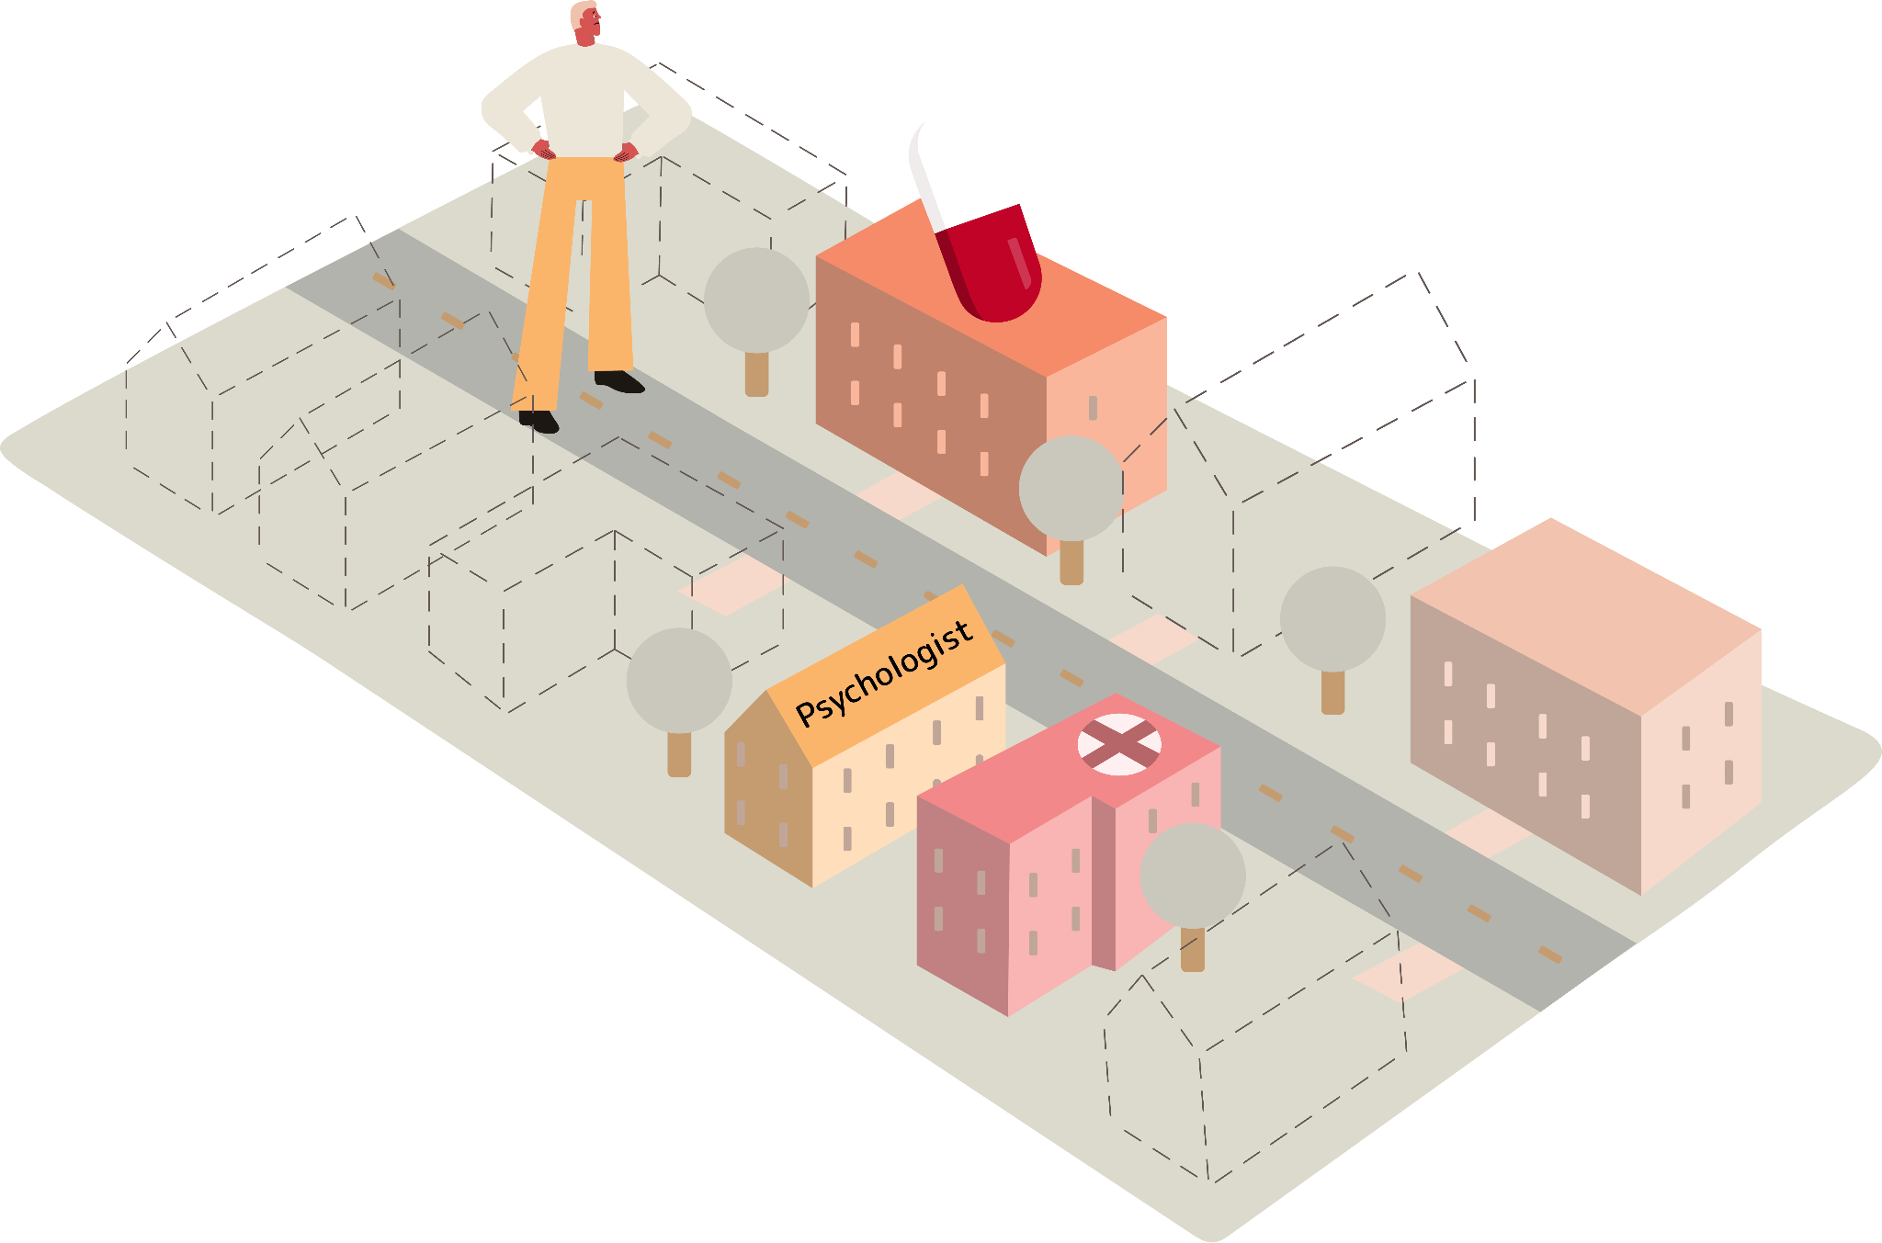
The Challenge

Slide 15
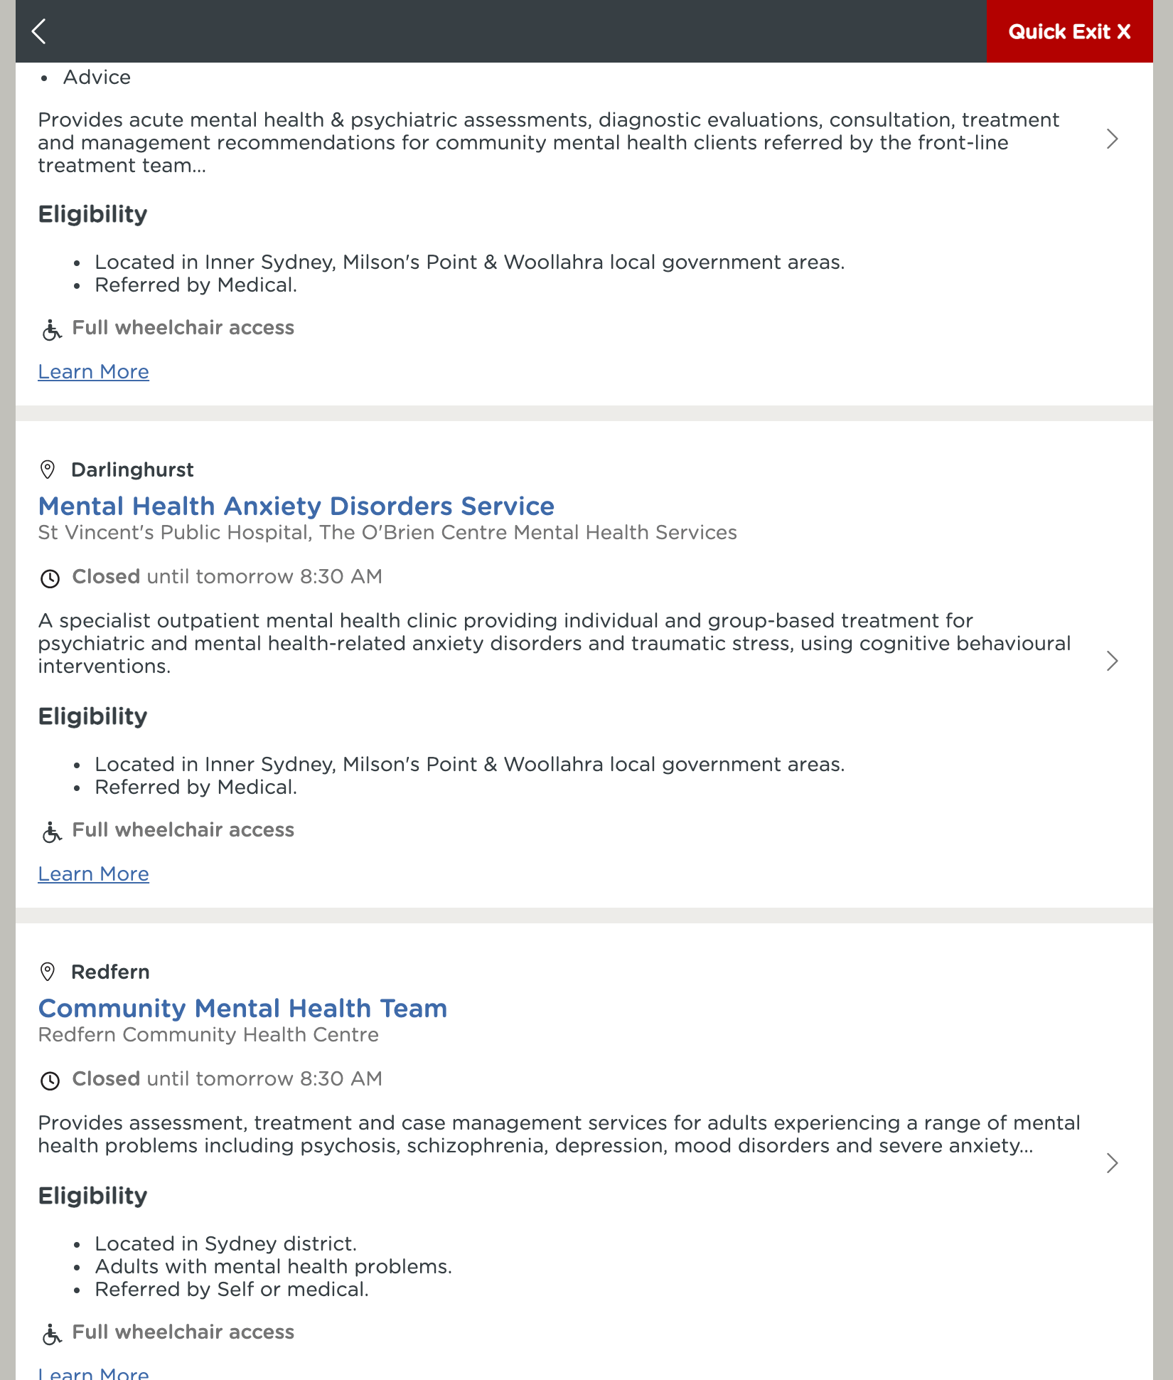
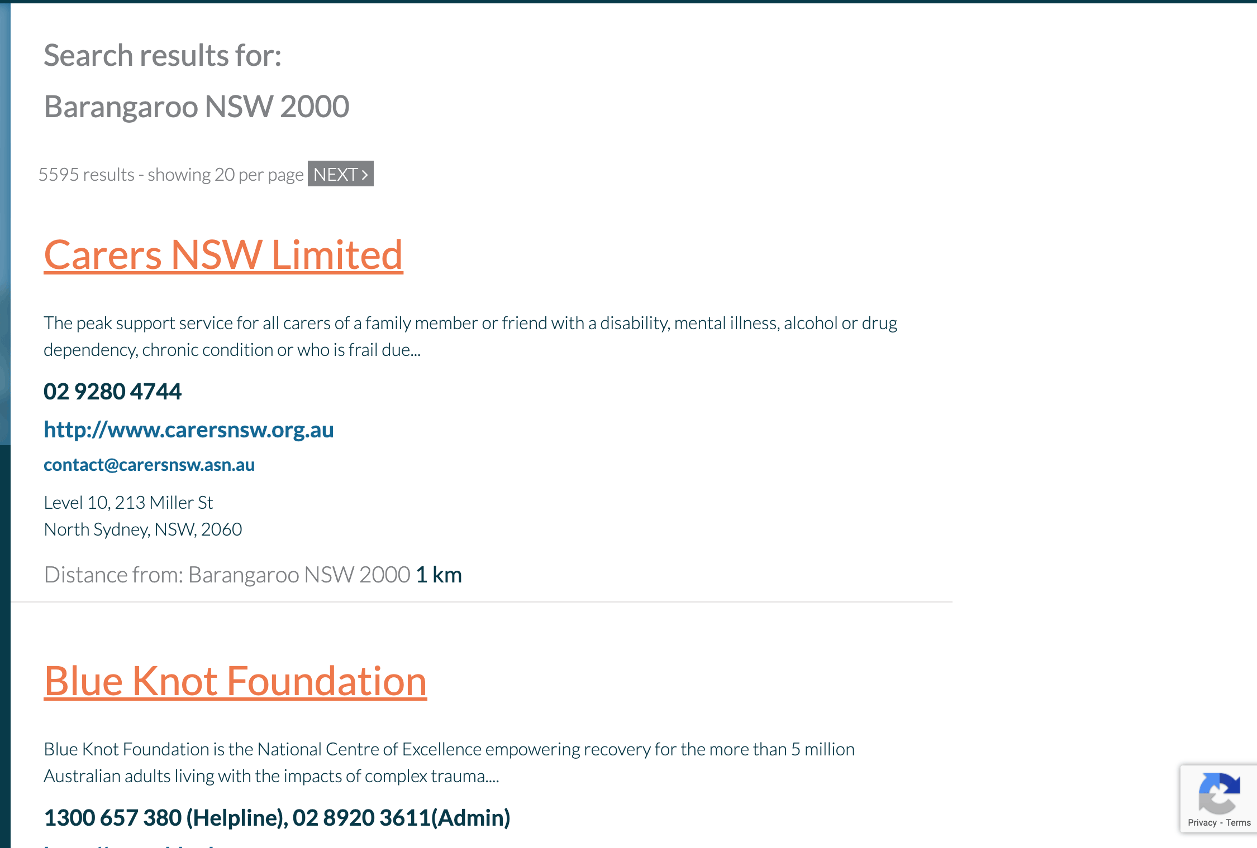

Slide 16
Increase Uptake for Clinicians
Through the Patient
Partnership with enablers- link workers, NGOs, technology
Coaching facilitators
Clear indications- presentations and appointment types

Slide 17
Increase Uptake for Clinicians
Professional Medical peer groups/college
Medical education - evidence and training
By example - normalise for colleagues
Share systems/workflow

Slide 18
Increase Uptake for Patients
Medicalise indication- have evidence base at hand
Clear communication
Normalisation and de-stigmatisation
Feedback loop

Slide 19
Increase Uptake for Patients
Enablement and choice
Tailored recommendation

Slide 20
Improving Implementation
Incorporate into patient-centred care models
Leverage funding opportunities
Advise programs, organisations and co-design participation
Advocate and raise awareness

Slide 21
Improving Implementation
Promote and develop colleagues with interest
Advise government and health bodies
Look internationally for gold standard and innovation
Stories

Slide 22
Promoting Sustainability
Advocate for system/EMR Integration
Innovation: tech and workflow
Advocate for funding and resources
Data and research
Notes:
Strong evidence SP improves mental health and wellbeing
Characteristic patient referred for SP: history of mental health problems, frequent health service user, and often multiple life issues.
Reductions in anxiety; improvement in self-reported wellbeing / QoL
Improvements in the the ability to carry out daily activities
Reductions in self-reported loneliness and isolation
Strong evidence of positive return on investment
E.g. SP in Rotherham UK (2016) > £500,000 NHS savings p.a.; ROI of £1.98 per £1 spent.
Transfer of services from health system to community supports, including volunteer sector
E.g. SP in Brighton and Hove UK (2018): £1.36 million p.a. GP time saved through referral to community supports

Slide 23
Promoting Sustainability
Advise health authorities and policy makers
Stories! Stories! Stories! Impact on your practice
Sustain and maintain community partnerships
Training and education

Slide 24
Promoting Sustainability
Familiarise yourself with cost effectiveness in:
Managing chronic disease
Reducing hospitalisations and reliance on doctor appointments
Improving wellbeing
Mental health
Loneliness
Health literacy

Slide 25
Prof. Kheng Hock Lee
MBBS, MMed (FM), FCFP, FAMS, FAMM, FRCP (London)
Senior Consultant Family Physician, Singapore General Hospital
Assistant Master (Clinical Affairs), Academy of Medicine Singapore
Past President, College of Family Physicians Singapore

Slide 26
Social Prescribing & Family Medicine for a Healthier Population
A/Prof Lee Kheng Hock MBBS, MMed (FM), FCFP, FAMS, FAMM, FRCP (London)
Senior Consultant Family Physician
Singapore General Hospital
Assistant Master (Clinical Affairs) Academy of Medicine Singapore
Past President, College of Family Physicians Singapore

Slide 27
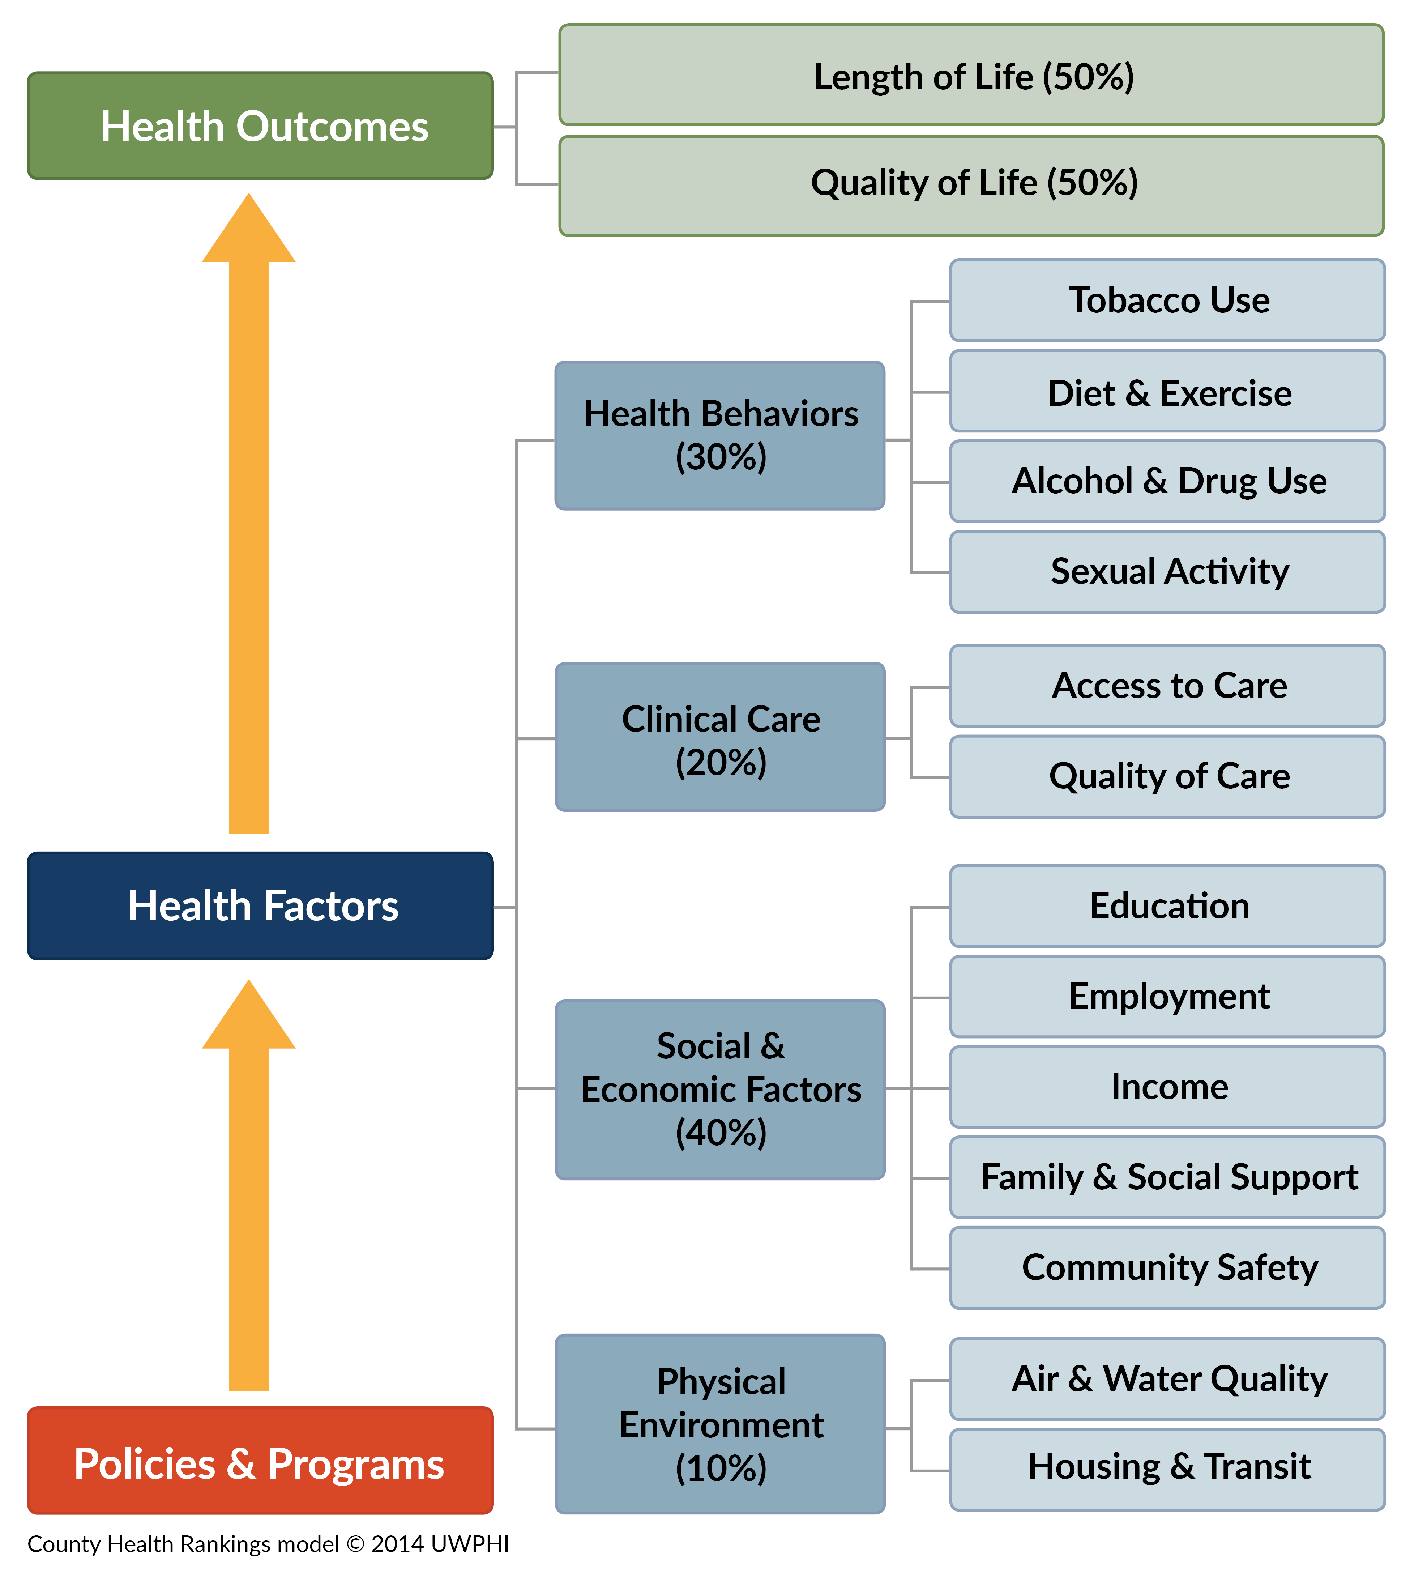
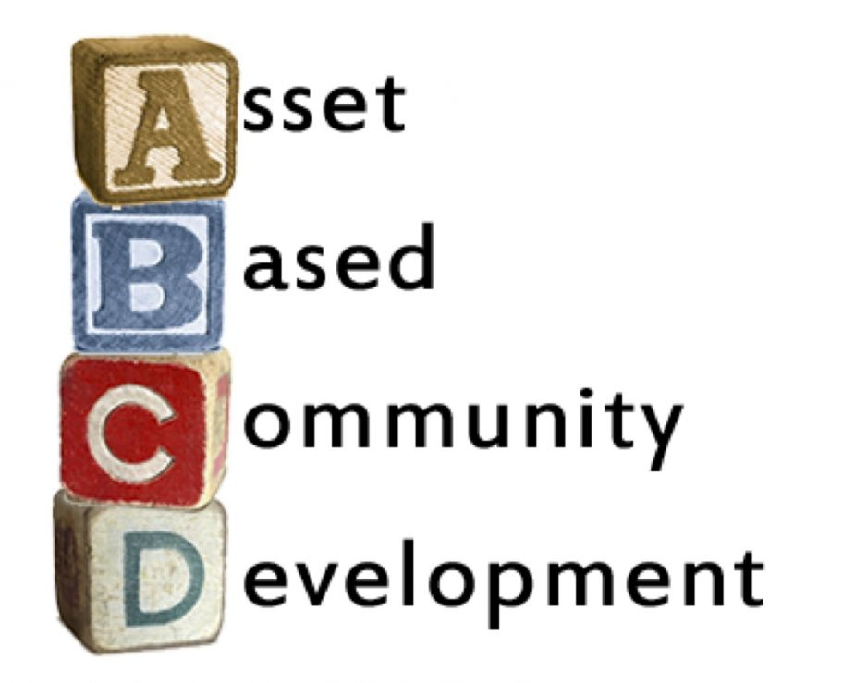
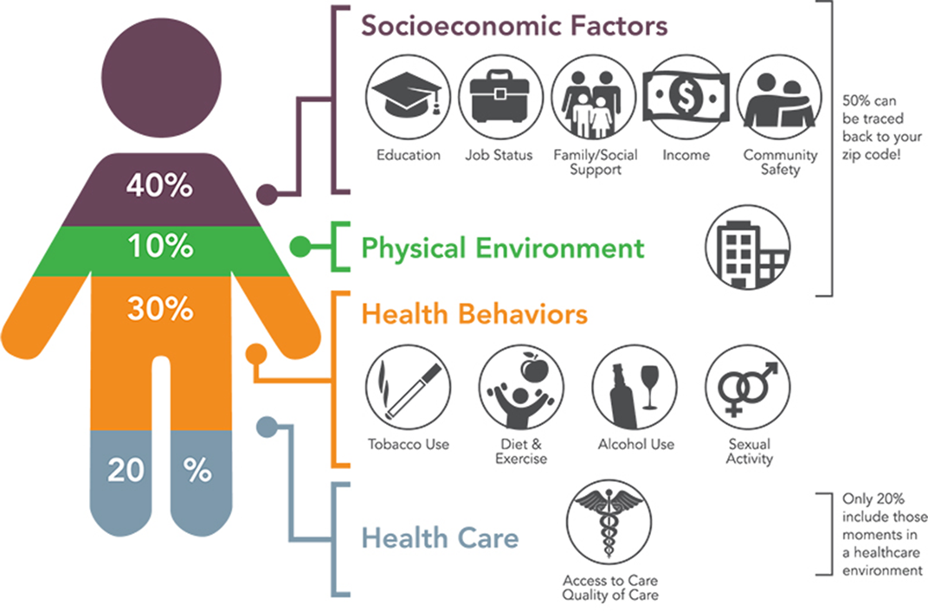
Program Theory of Social Prescribing for Implementation
“Social prescribing seek to improve the wellbeing of patients by optimizing their social determinants of health through connections to community assets” SingHealth Community Hospitals
Context
Mechanism
Outcome

Slide 28
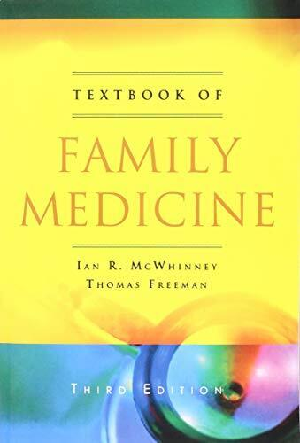
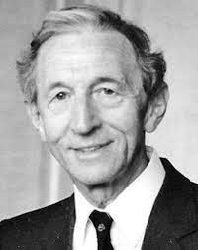
What it Means to be a Family Doctor?
“The family physician sees himself or herself as part of a community- wide network of supportive and healthcare agencies. All communities have a network of social supports, official and unofficial, formal and informal. The word network suggests a coordinated system.”
Dr Ian McWhinney 1926 – 2012
“Founding Father of Family Medicine” Canada

Slide 29
Healthier SG: Population Health for Singapore
5 core elements
MOH Vision
Championing a healthy nation with our people
To live well, live long & with peace of mind
Mobilize family doctors for preventive care
Every resident to have a care plan
Community partnerships for social prescribing
Nationwide enrolment programme
Provide enabling support structures (manpower, finance, IT)
1
Desired Outcomes for each Resident
Take ownership of their health
Make healthier choices in their daily lives
All partners working together to support healthier lifestyles and outcomes
2
MOH working with Clusters as Regional Health Managers to deliver:
One Primary Care Provider that residents see regularly.
Personal Health Plan that includes national preventive care recommendations.
Community programmes, activities, & services that help them choose a healthier lifestyle.
3
4
5
Source: Healthier SG Implementation – Main Workgroup Meeting (7 May 2022)

Slide 30
Defining Family Medicine (6 Element)
Notes:
Why is SP more than just relevant to FM?
The uniqueness of FM as a specialty

Slide 31
Family Medicine for Healthier SG
Personal | Care that is contextualized to the whole person: One health plan
Primary | Physician of initial contact and principal point of continuity: Enrolment of every Singaporean to a family doctor
Preventive | Beyond treating diseases to optimizing health and wellbeing: Not just minor acute illnesses
Comprehensive | Encompassing the biopsychosocial domains of health: Regular scheduled check-ins Vaccination + screening Chronic disease management Social prescribing
Continuing | Caring for the patient in the healthcare journey: Integrated with the RHS through PCN and team-based care
Co-ordinated | Connecting health and social care providers: Working with RHS place-based teams and community partners

Slide 32
A Complete and Holistic Care Plan
“Clinical”
Prescription
“Social”
Prescription

Slide 33
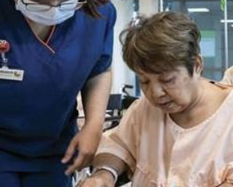
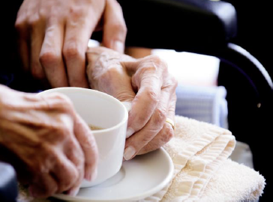
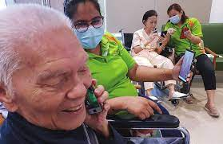
Training for Healthier SG (Clinicians)
Restricted, Sensitive (Normal)
1
Essentials of Social Prescribing
2
Transitional & Home Care
3
Assessment & Care Planning for Complex Patients
4
Essentials of Pop Health & Implementation Science
5
Foundations in Integrated Care
A series of 8 lectures with optional workshop on core knowledge and skills useful in the practice of social prescribing. The objective of the course is to introduce key concepts in social prescribing to busy practitioners. At the end of program, the learner will be able to incorporate social prescribing concepts in their daily work.
What this programme covers:
Ethical Issues and Dilemmas
Social Prescribing (SP) and SDOH
Understanding the Patient’s Needs
The Goals of SP
Returning Patients to their Community
Team Based SP
Ethics and Self-Care
12 Hours
6 Learning Units
The prevalence of multiple co-morbidities is rising. Many such patients have complex care needs. They need transitional and even home care support after an episode of hospital care. This course enable learners to apply their clinical skills and knowledge in the setting of home and transitional care.
What this programme covers:
Common medical conditions that limit ADLs
Transitional home care
Home care
Multidisciplinary care
Activities of Daily Living
24 Hours
Case Studies
With the aging population and increasing prevalence of complex co-morbidities, being able to make comprehensive assessment and care plans has become a critical competency for clinicians. Learners will learn the use of systematic approach of developing a person- centered care plan.
What this programme covers:
Biopsychosocial approach to care planning
Concepts in care integration
SBAR4 Framework for complex patients
16 Hours
Case Studies
People live in communities which influence their state of health. Good care for lifestyle related conditions, optimal living conditions and policies that support these are increasingly recognized as important determinants of good health. This course enables learners to appreciate healthcare from a systems perspective.
What this programme covers:
Introduction to population health
Introduction to implementation science
Organization of health care systems
Translation of policies to programs
Implementation of population health programs
16 Hours
Case Studies
The course equips new Wellbeing Coordinators with the foundational knowledge and skills to perform their job responsibilities to better support the Healthier SG initiative.
What this programme covers:
Essentials of integrated care
Effective communication techniques
Personalised care plans to support preventive health
Monitoring parameters
Understanding home assessment
38 Hours
5 Modules
Institutional Collaboration
5 courses

Slide 34
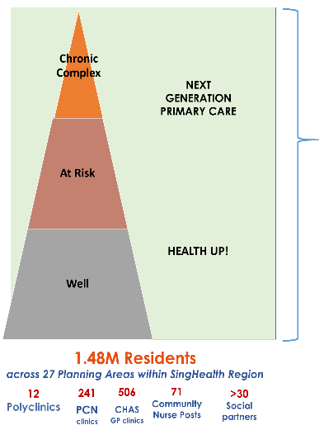
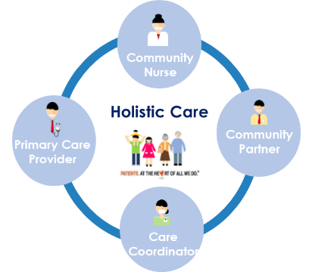
SingHealth Healthier SG Teams
SingHealth’s Healthier SG Teams
Place based approach
Deep understanding of needs and aspirations of residents and partners in the locality
Embedded as a team with local PCPs and Community Partners within defined locality
Coordinating care for health-social care integration
Harmonised framework and enablers
Flexibility for local needs of providers and community
Ensuring person-centeredness and community orientation
From delivering programmes to meeting needs.

Slide 35
Health Plans for the WBC/CC
Deliver though HealthHub App or Hardcopy
The Health Plan should contain the following for Residents:
Vaccination and Screening Goals
Lifestyle Goals
Condition Goals
Activity Goats

Slide 36
Beyond History Taking
Housing environment
Finances
Food security
Social connection
Caregiver
Access to healthcare
Digital inclusion
Community assets available
PERMA

Slide 37
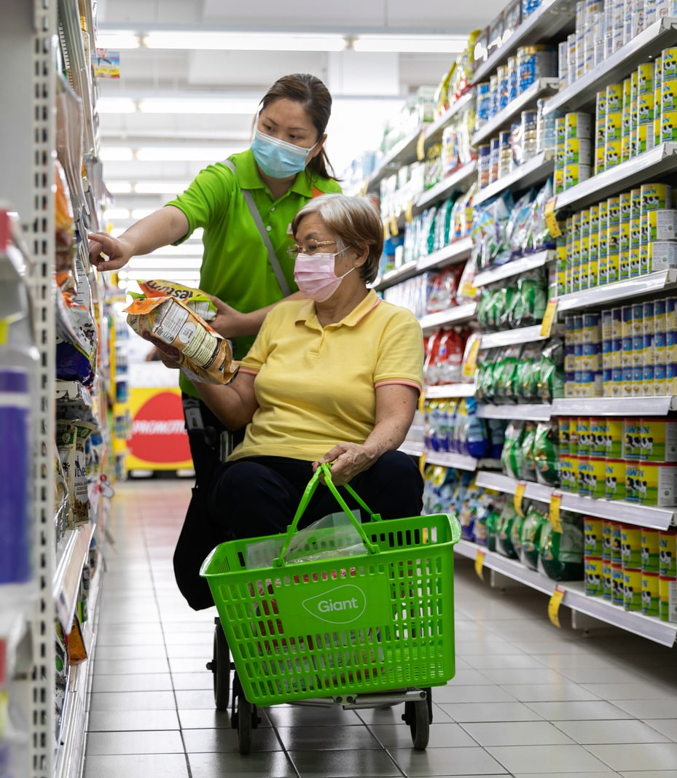
Working with Social Prescribing Practitioners
What do they do?
Assess social determinants of health
Social prescribing care plans
Activating patients through activities
Improve wellbeing
Linking patients to community partners
How can they help you?
Follow up on patients with your care plan
Report back on developments
Supporting adherence
Connecting with community nurses, colleagues in public health institutions

Slide 38
Q&A Session

Slide 39
Get in touch
socialprescribingacademy.org.uk
@NASPTweets
@NASP_insta

