Slide 1
NASP webinar: NAVCA Social Prescribing Project
Conor Smith - Projects Officer at NAVCA, Chair
Charlotte Osborn-Forde - CEO, NASP
Maddy Desforges - CEO at NAVCA
Spirit of 2012
Kirsten Ingram - Strategic Lead – Social Prescribing at Voluntary Centre Services
Bruce Poole - Strategic Lead and Social Prescribing Programme Manager at Salford Community and Voluntary Services

Slide 2

Housekeeping
Please note we are recording this webinar (you will be sent the slides and the link to the recording, and they will be on NASP's website too.)
Presentations, then a Q&A session at the end.
Please submit questions via the chat.
Please use the chat for introducing yourself and networking.
Please stay on mute and camera off.

Slide 3
Accessibility
Closed Captions are available – turn these on at the bottom
of your screen
BSL interpretation is available – the interpreters will be spotlit
Please put any technical questions into the chat

Slide 4

Overview of session
Conor Smith - Projects Officer at NAVCA, Chair
Charlotte Osborn-Forde - CEO, NASP
Maddy Desforges - CEO at NAVCA
Spirit of 2012
Kirsten Ingram - Strategic Lead – Social Prescribing at Voluntary Centre Services
Bruce Poole - Strategic Lead and Social Prescribing Programme Manager at Salford Community and Voluntary Services
Q&A session – 30 minutes
Q&A – 30 mins

Slide 5
Conor Smith
Projects Officer, NAVCA

Slide 6
Charlotte Osborn-Forde
CEO, NASP

Slide 7
New Strategy
Five key ambitions to transform the scale and impact of social prescribing;
Connection
Innovation
Investment
Evidence
Awareness

Slide 8
Key priorities for influencing
Influence new GP contract post Mar 24
SP in every clinical pathway- eg Major Conditions strategy
Data and Insight Centre / Commissioning support for ICBs
Shared Community Investment Fund models – eg Power of Music

Slide 9
Collaboration with NAVCA
Unique reach into local communities
Expertise
Maximise resources and impact
Strategic voice and insight

Slide 10
Maddy Desforges
CEO, NAVCA

Slide 11

NASP-NAVCA Webinar: Social Prescribing in the VCSE
Maddy Desforges, CEO
22 August, 2023
maddy.desforges@navca.org.uk

Slide 12
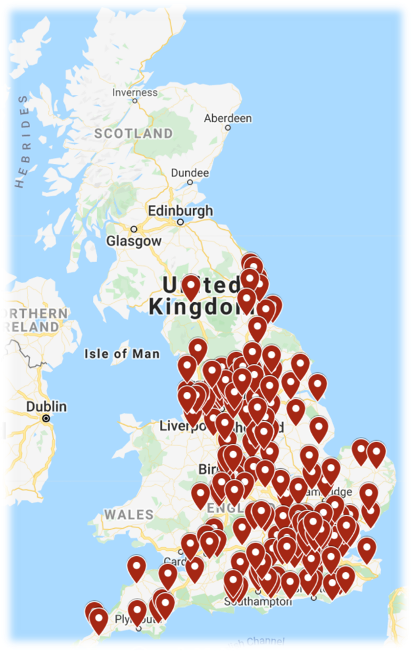
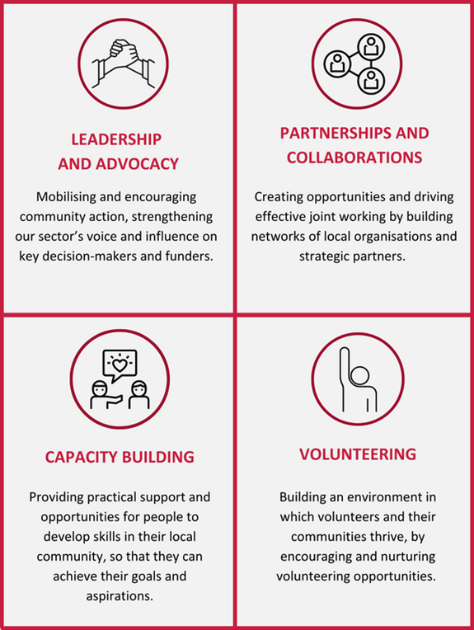

NAVCA - Who We Are

Slide 13
Aid PCNs and HOs establish, develop and maintain a sustainable and effective social prescribing scheme in a local area.
Living resource intended to be used as part of a larger raft of resources

Slide 14
Example Section
5 Connections into wider system SPLWs are part of the wider integrated and personalised health and care network and do not exist in a vacuum. To do their job effectively and ensure the PCN and HO are delivering an impactful social prescribing scheme, mechanisms must be put in place for SPLWs to be connected into the wider system.
Categories and specific elements |  | Resources / Links to support
5.1 | Relationship exists with other SPLWs and other Additional Roles Reimbursement Scheme roles (ARRS) roles (e.g. Health & Wellbeing Coaches, Care Coordinators, Community Pharmacists, etc.) Towards excellence: There are formal networking opportunities for all personalised care staff employed within the ARRS roles across a PCN, irrespective of their host employer. | Redbridge CVS case study
5.2 | Communication exists between SPLW and PCN/GP Federation staff and other health providers in system, e.g. SPLWs spend time in GP surgeries, meet with other PCN staff, attend appropriate meetings including Multi-Disciplinary Team (MDT) meetings and local ‘huddles’ to discuss clients; joint working is encouraged. | Living Well Sefton / Sefton CVS case study NAVCA LIO and PCN Engagement Toolkit (forthcoming)
Notes:
Example

Slide 15
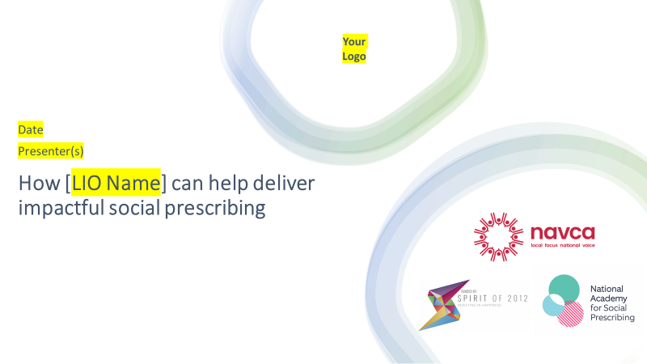
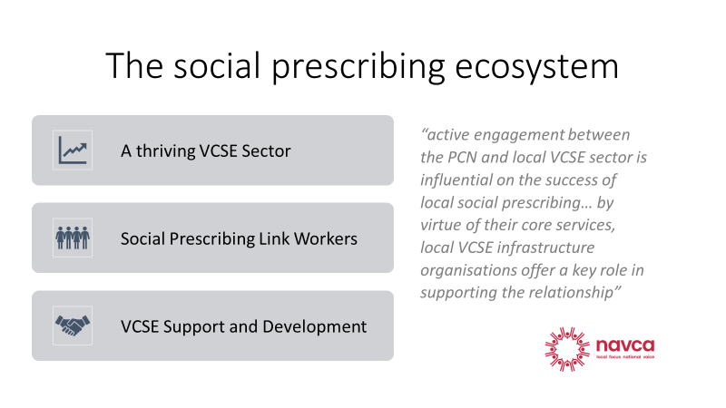
Social Prescribing PCN Engagement Toolkit
“The presentation will support LIOs to engage with stakeholders about social prescribing”

Slide 16
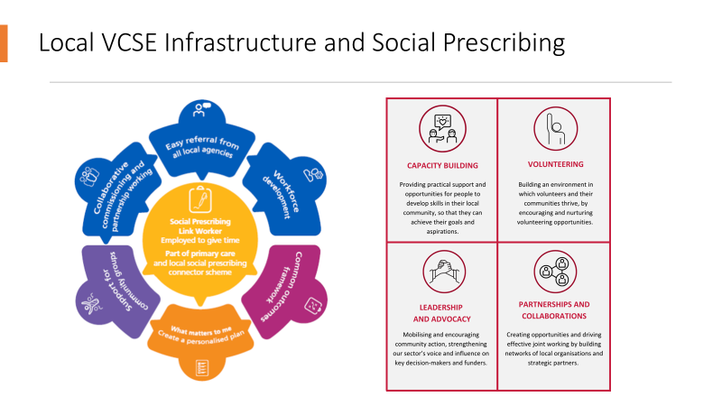
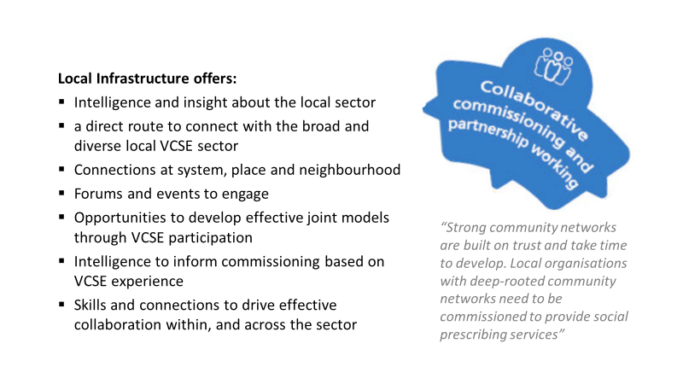
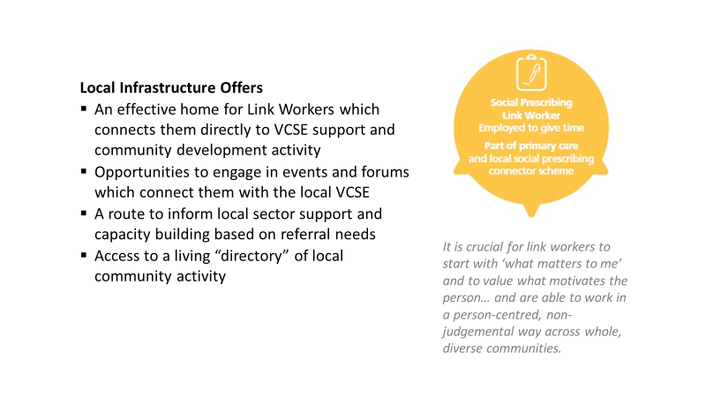
“Slides 5 to 9 provide an opportunity to highlight how your work relates directly to the elements of the standard model of social prescribing.”
“Each slide includes a relevant quote from NHS England’s Social Prescribing: Reference Guide and Technical Annex for primary care networks and a bullet point list highlighting the areas the Four Functions of Infrastructure support the requirements and aims.

Slide 17


Further Reading and Resources
Case study materials
Reports on role of VCSE in Social Prescribing
LIO member organisation networks
https://navca.org.uk/social-prescribing
SLPW Host Organisation Self-Assessment
Evidence bank
Case studies
https://socialprescribingacademy.org.uk/

Slide 18
Amy Finch
Spirit of 2012

Slide 19
Kirsten Ingram
Strategic Lead – Social Prescribing at Voluntary Centre Services

Slide 20





Benefits and added value of hosting SPLW’s in the VCSE sector

Slide 21
Where we cover
Voluntary Centre Services cover the South Lincoln villages, Lincoln City North and South and Gainsborough with our sister organisation Lincolnshire Community and Voluntary Service covering Boston, East Lindsey, Spalding, Grantham and Sleaford.
There are also a handful of PCN’s across the county who offer social prescribing internally.
Alongside Social Prescribing we also offer a package of community development support services including a brokerage service, group support and other projects that look to engage those who are economically inactive, those looking for work and those who want to brush up on their maths skills through cooking, geo art and other avenues

Slide 22
What are our collective aims as the SP service?
Deliver a flexible, person centred and holistic service
To connect clients to existing provisions in their communities
Help prevent or reduce a need for clinical intervention
Integration within Neighbourhood Working
Support clients with identifying and achieving goals
Offer appropriate levels of support depending on clients needs
Be visible within our local community
Supporting the community with its own goals

Slide 23
Benefits to Staff
Our link workers have the time to build better and more meaningful relationships with voluntary and community sector and reach out to those small community groups
Being part of the VCSE sector enables us to access and unlock different training, funding and more support mechanism as a result of our charitable status
Staff have permission to think more creatively than some of our commissioned colleagues.
Time to effectively integrate in the community as part of their Social prescribing Link Worker Role aren’t restricted to working within clinical environments
Peer support for link workers, managers and other staff across the county

Slide 24
Benefits to Social Prescribing
Log and keep an up to date database of community assets and pass this information and expertise to other services if required
Ability to help with more than just Social Prescribing for both clients and groups - signpost them easily to further help and support within LCVS or VCS is needed
VCS and LCVS work collaboratively to ensure that clients receive the same care no matter which organisation they are referred to – standards set of how we deliver projects and shared SOP
Shared case management system, SRX and we could work together to procure this as well as our volunteer system which is compatible with our SP system
We were able to create the Lincolnshire Voluntary Engagement Team - we saw the need for the VCSe to be represented at the same level as statutory colleagues and created a body to allow us to do that. LVET is a collective of voluntary groups and organisations of all shapes and sizes, who have an interest in working with health and care partners to develop and deliver services for all.

Slide 25
Wider Benefits
Groups, organisations and services are able to develop a single meaningful relationship with our organisation that helps them receive the same type of holistic support as we offer to clients.
Example: Stepping Stone Theatre in Gainsborough who said, they are very supportive of social prescribing but that they didn’t want referrals from all or want to be on a directory- they wanted us to send the right people to them so that everyone can participate effectively.
As well as helping with wider elements of support for groups that already exist our approach allows us to easily identify and support service gaps.

Slide 26
If you have any Questions or want to Connect
Website
Voluntary Centre Services - https://voluntarycentreservices.org.uk/
Lincolnshire Community and Voluntary Service - https://www.lincolnshirecvs.org.uk/
Contacts
VCS – Kirsten Ingram Kirsten@voluntarycentreservices.org.uk
LCVS – Chey Brown or Sonia Lewis cheybrown@lincolnshirecvs.org.uk or sonialewis@lincolnshirecvs.org.uk

Slide 27
Bruce Poole
Strategic Lead and Social Prescribing Programme Manager at Salford Community and Voluntary Services

Slide 28


Wellbeing Matters in Salford
  Bruce Poole
  Strategic Lead PCCA
  GM Lead for Thriving Communities (NW)
0-25
Integrated
Transformation
Place
Community
Initiative
Work
Assets

Slide 29


Wellbeing Matters – two goals
To help reduce inappropriate demand on costly areas of health provision in Salford
To contribute to improving the health and wider wellbeing of Salford residents through person and community-centred approaches, including the creation of a social prescribing model for Salford alongside wider support for the VCSE eco-system

Slide 30

Background
VCSE led programme of work in Salford established in 2017 with GM Transformation funding
Strands of work - social prescribing / community connection; building the VCSE ecosystem through volunteering, voluntary action, & community activities
Focuses on Person and Community-Centred Approaches; strengths / asset-based; generating social value
SCVS is the lead organisation (SRO) and the programme is delivered in partnership with Salford Third Sector Consortium
Now funded by NHS GM, all 5 Salford PCNs; the Salford Integrated Mental Health, the Assoc of Colleges and Salford City Council, & NHS Northern Care Alliance
Enhanced by Salford CVS managed grant funding, which resources some of the community activity that supports social prescribing in Salford

Slide 31

Wellbeing Matters – delivery model
GM Mental Health Trust
Workstream 1 – building a neighbourhood infrastructure with five VCSE anchor organisations, each hosting a FTE Community Connector, supported by a Social Prescribing Coordinator
Other health providers
VDW
Social Value
Salford City Council
SRFT
VDW
VCSE ANCHOR
CC
Workstream 2 – developing capacity in local communities to support volunteering and voluntary action around the 5 ways to wellbeing via five FTE Volunteering Development Workers (2 via Community Assets), building the eco-system to socially prescribe into
VCSE ANCHOR
CC
VCSE ANCHOR
CC
NHS Salford CCG
VCSE Sector
5 Neighbourhoods
Salford Together
VDW
VCSE ANCHOR
CC
VCSE ANCHOR
CC
Workstream 3 – embedding a social value approach to achieve wellbeing outcomes via 1 FTE Social Value Development Worker (including supporting Salford’s Social Value Alliance and its 10% Better campaign)
VDW
VDW
VCSE organisations
GP practices / SPCT /
PCNs
Local businesses

Slide 32


Wellbeing Matters – delivery model 2023
GM Mental Health Trust
CC
Social Prescribing – 5 VCSE anchor organisations, hosting Community Connector/s, plus a ‘City Wide’ CC, a Mental Health CC, a Long Covid CC and a Colleges Connector. All supported by a Social Prescribing Coordinator (21 Connectors and counting )
Other health providers
CC
CC
CC
CC
NHS NCA
SRFT
CC
CC
DW
Salford City Council
Primary Care Networks
GSP DW
VCSE ANCHOR
CC
CC
Development – building capacity in local communities so we have a healthy VCSE eco-system to socially prescribe into. Supported by 3 FTE Development Workers and some Third Sector Fund grant monies
CC
CC
CC
VCSE ANCHOR
CC
VCSE ANCHOR
CC
NHS GM
VCSE
5 Neighbourhoods
Salford Together
DW
Green Care – Developing the Green and Blue eco-system and partnerships. through the Green Space Development Worker
VCSE ANCHOR
CC
CC
VCSE ANCHOR
CC
CC
Green Care
Living Well
CC
DW
DW
Home First: Hospital Discharge – hybrid Community Connector for people needing connections / support in their community to go home from hospital
Diabetes Support - LTC Specific Connector
Salford City College
VCSE organisations
CC
CC
CC
CC
CC
CC
Local businesses
CC

Slide 33

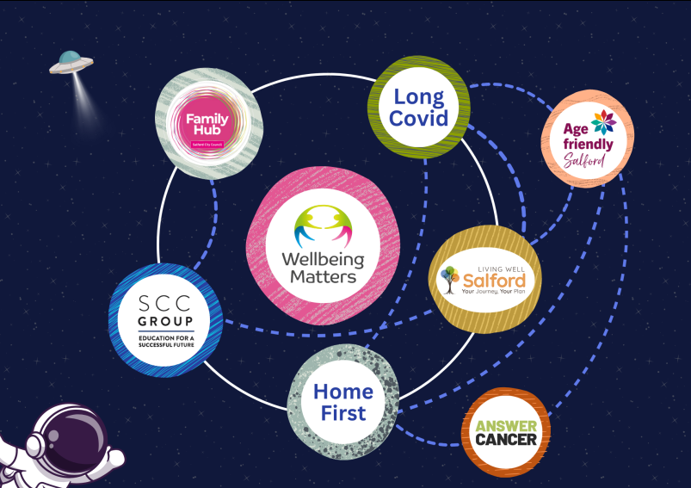
Interconnectivity: more than Wellbeing Matters

Slide 34

Wellbeing Matters 2022 - 2023
In total there have been 9,214 referrals to Wellbeing Matters since December 2018
3,669 referrals a 40% increase on 2021/22 and 86% on 2020 – 21and 244% on our first year
3,353 (91.5%) of referrals were from PCN teams, 62 from the ASC Centre of Contact and 213 from the Living Well team
3, 332 (91%) became ‘live cases’ – 83 inappropriate, 133 duplicate referrals or 70 declined
19,554 appointments completed (average of 6 per client)
Community Connectors have provided 3728 connections out, 77% (2,873) were to voluntary, community and social enterprise providers and 1342 (23%) referrals to formal service provision

Slide 35
Wellbeing Matters 2022 - 2023
Over 200 VCSE groups supported to be ‘ready’ to receive social prescribing referrals from Wellbeing Matters; this included 728 IAG and 347 capacity building sessions
The WM Development team engaged with 42 VCSE groups to promote the role of volunteers in supporting their organisation to accept referrals from Wellbeing Matters with 89 new volunteering opportunities developed
82 WM clients referred for volunteering by Community Connectors
The WM Development Workers have undertaken a quality assurance review of 150 groups receiving connections from the programme
22 Groups awarded WM Community/ Green Assets Funding (£241k) to provide new activities for people connected from Wellbeing Matters

Slide 36


Demographics 22-23
Gender
59% Female
40% Male
1% Non-Binary / Transgender
40%
61% (957) people self - report that they have a Long-Term Condition
45% (693) as having a Disability

Slide 37


Reason for referral 22-23
Of 3,728 referrals 2,397 (64%) referrals had more than one reason for referral
Asylum-seeker support
Smoking cessation
Literacy and communication
Carers support
Self management
Notes:
Mental Health 34% (which has reduced from 37% in Q4) and Social Support 22% (slight increase from 21% in Q4) being main reasons for referral
37

Slide 38
3,728 Connections made 2022-2023
77% Connected to VCFSE Provision
33% to Public or other sectors
Notes:
38

Slide 39
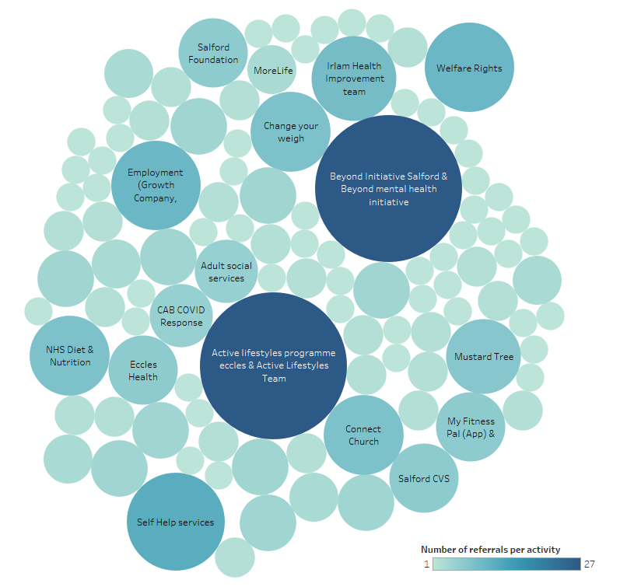
A group or activity for everyone >
Building and connecting into the VCSE & neighbourhood ecosystems

Slide 40


It’s all about Outcomes
Personal outcomes
Community outcomes
Population Health outcomes
VCSE activities
Healthy life choices, feeling less lonely, taking part in physical activity, reduced anxiety and depression,
Self-care of long-term conditions
System outcomes
People feeling connected to their local neighbourhood, shared strengths and assets, increased community resilience, empowered communities
Reduced obesity, improved mental and emotional health, increased confidence, self-management of asthma, diabetes, cardio-vascular disease, improved healthy life expectancy
GP visits avoided, reduced emergency admissions, reduced attendance at A&E, reduced permanent admissions to care, less medication waste and reduced cost of medication

Slide 41
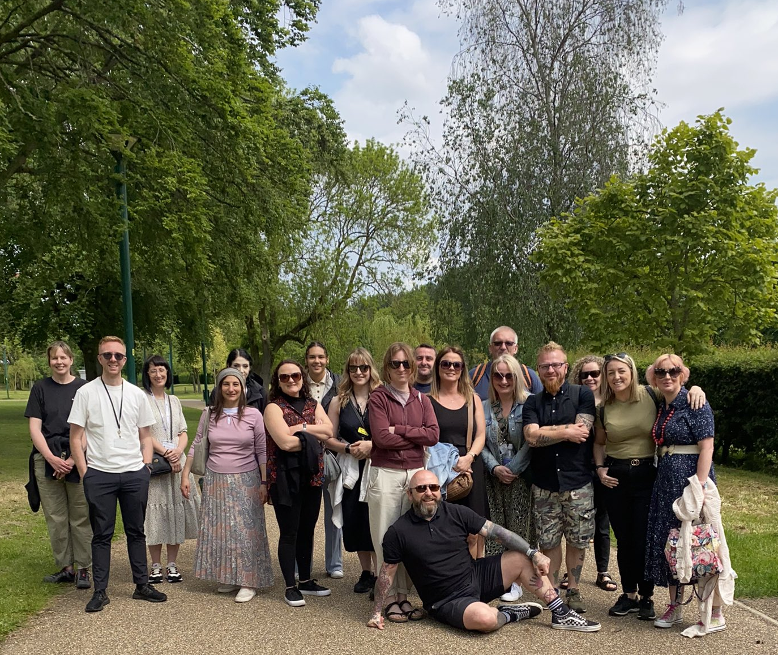
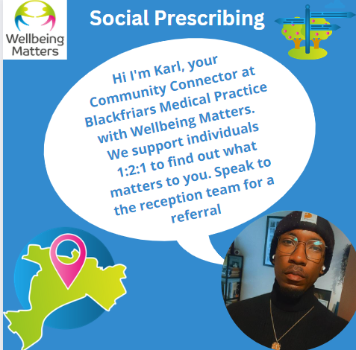


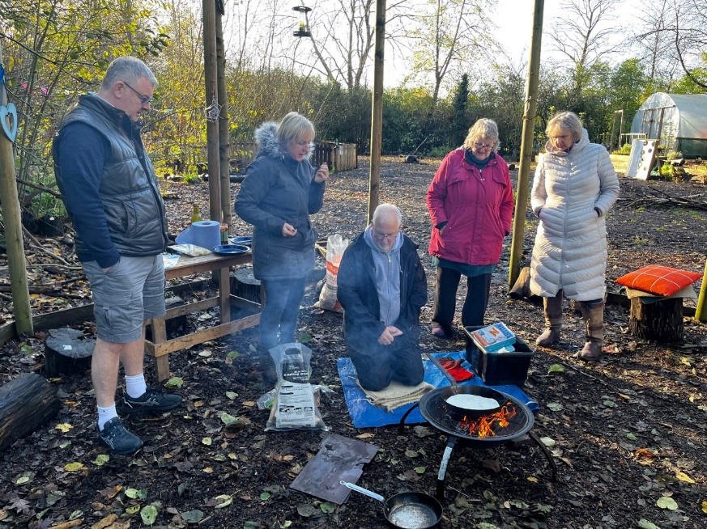
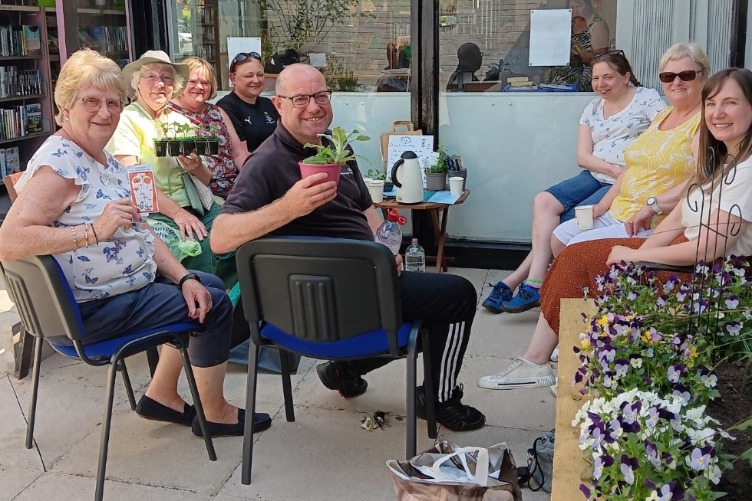

Slide 42
Any Questions?

Slide 43




Get in touch
socialprescribingacademy.org.uk
@NASPTweets
@NASP_insta

